Slide 1
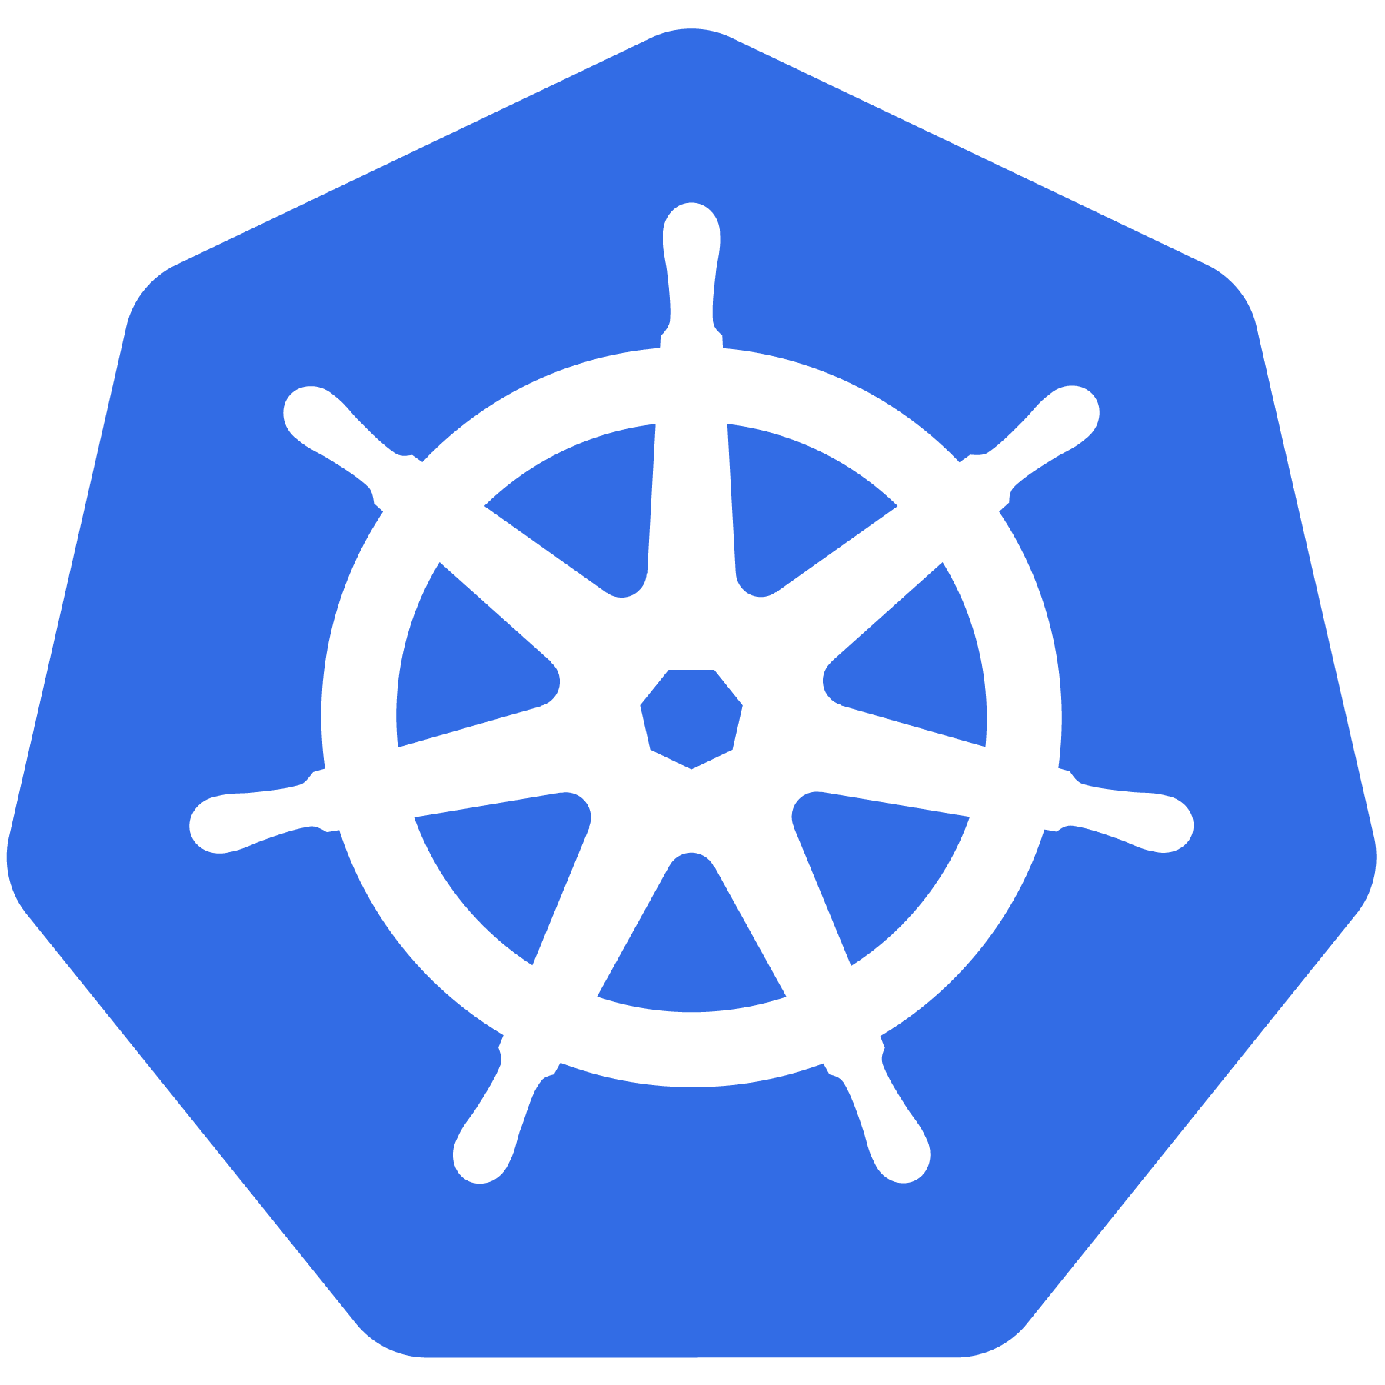

Kubernetes
An Introduction

Slide 2
Prerequisites
Basic knowledge of a Container Technology (Docker) – Nice to have.
Willing to learn something new.
Collaborate with comments, if you have any.
No fear to ask questions.

Slide 3

References
The Original Version of this presentation and more material: https://github.com/cncf/presentations/tree/master/kubernetes
EDX Course – Introduction to Kubernetes: https://courses.edx.org/courses/course-v1:LinuxFoundationX+LFS158x+1T2018/course/
And THE BEST resource about Kubernetes:
Notes:
Public available presentation from Cloud Native Computing Foundation (CNCF)
Extended for our internal usage

Slide 4

If you want to try
Requirements:
Minikube: https://github.com/kubernetes/minikube
Virtualbox*: https://www.virtualbox.org/wiki/Downloads
kubectl: https://kubernetes.io/docs/tasks/tools/install-kubectl/
k8s-intro-tutorials repo: https://github.com/mrbobbytables/k8s-intro-tutorials

Slide 5
Project
Overview
Notes:
Quick overview of the project and what Kubernetes it

Slide 6

What Does “Kubernetes” Mean?
Greek for “pilot” or
“Helmsman of a ship”
Image Source
Notes:
The first question always asked

Slide 7
What is Kubernetes?
Project that was spun out of Google as an open source container orchestration platform.
Built from the lessons learned in the experiences of developing and running Google’s Borg and Omega.
Designed from the ground-up as a loosely coupled collection of components centered around deploying, maintaining and scaling workloads.
Borg: https://ai.google/research/pubs/pub43438
Notes:
Kubernetes is a container orchestrator!
borg is the man behind the curtain managing everything in google
Kubernetes is loosely coupled, meaning that all the components have little knowledge of each other and function independently.
This makes them easy to replace and integrate with a wide variety of systems

Slide 8
What Does Kubernetes do?
Known as the linux kernel of distributed systems.
Abstracts away the underlying hardware of the nodes and provides a uniform interface for workloads to be both deployed and consume the shared pool of resources.
Works as an engine for resolving state by converging actual and the desired state of the system.
Notes:
linux kernel of distributed systems
Sort of like a hypervisors, in that it abstracts away the underlying host resources and shares them in a normalized way.
the underlying substrate or platform to build your applications and tools on top of
Think of Kubernetes like a higher-level language for your application architecture.
you describe what you need and it tries to resolve it
with that in mind, it acts as an engine to resolve state using the abstracted resources to deploy and manage your application.
It is declarative, and not imperative. You tell it or “declare” what you want, and it figures out the rest.
imperative you tell something every step you want it to do
declarative you tell it what you want it to be, and it figures it out
e.g. ‘I want 5 instances of x’ and it just does it, if something dies, it brings it back to get to 5

Slide 9
What can Kubernetes REALLY do?
Autoscale Workloads
Blue/Green Deployments
Fire off jobs and scheduled cronjobs
Manage Stateless and Stateful Applications
Provide native methods of service discovery
Easily integrate and support 3rd party apps
Notes:
when we go to production, we do not have the same liberty, as we need to ensure that our applications:
Are fault-tolerant
Can scale, and do this on-demand
Use resources optimally
Can discover other applications automatically, and communicate with each other
Are accessible from the external world
Can update/rollback without any downtime.

Slide 10

Most Importantly...
Use the SAME API across bare metal and EVERY cloud provider!!!
Notes:
Single biggest value-add Kubernetes can offer
Automatic binpacking Kubernetes automatically schedules the containers based on resource usage and constraints, without sacrificing the availability.
Self-healing Kubernetes automatically replaces and reschedules the containers from failed nodes. It also kills and restarts the containers which do not respond to health checks, based on existing rules/policy.
Horizontal scaling Kubernetes can automatically scale applications based on resource usage like CPU and memory. In some cases, it also supports dynamic scaling based on customer metrics.
Service discovery and Load balancing
Automated rollouts and rollbacks Kubernetes can roll out and roll back new versions/configurations of an application, without introducing any downtime.
Secrets and configuration management
Storage orchestration With Kubernetes and its plugins, we can automatically mount local, external, and storage solutions to the containers in a seamless manner, based on software-defined storage (SDS).
Batch execution Besides long running jobs, Kubernetes also supports batch execution.

Slide 11

Who “Manages” Kubernetes?
The CNCF is a child entity of the Linux Foundation and operates as a vendor neutral governance group.
Notes:
CNCF is a sub-foundation of the Linux Foundation
A vendor neutral entity to manage “cloud native” projects
Projects that are “cloud native” generally focus on:
containers
dynamic orchestration
enable “microservice” deployment methodologies
can be logging, monitoring, containerizers etc
Kubernetes was the first project under the CNCF, and the first to be “graduated”
Kubernetes was started by Google and, with its v1.0 release in July 2015, Google donated it to the Cloud Native Computing Foundation (CNCF).

Slide 12

Project Stats
Over 40,000 stars on Github
1700+ Contributors to K8s Core
Most discussed Repository by a large margin
41,000+ users in Slack Team
07/2018
Notes:
Very active project
37k starts on github
1500+ contributors to main core repo
most discussed repo on github
massive slack team with 36k+ users

Slide 13
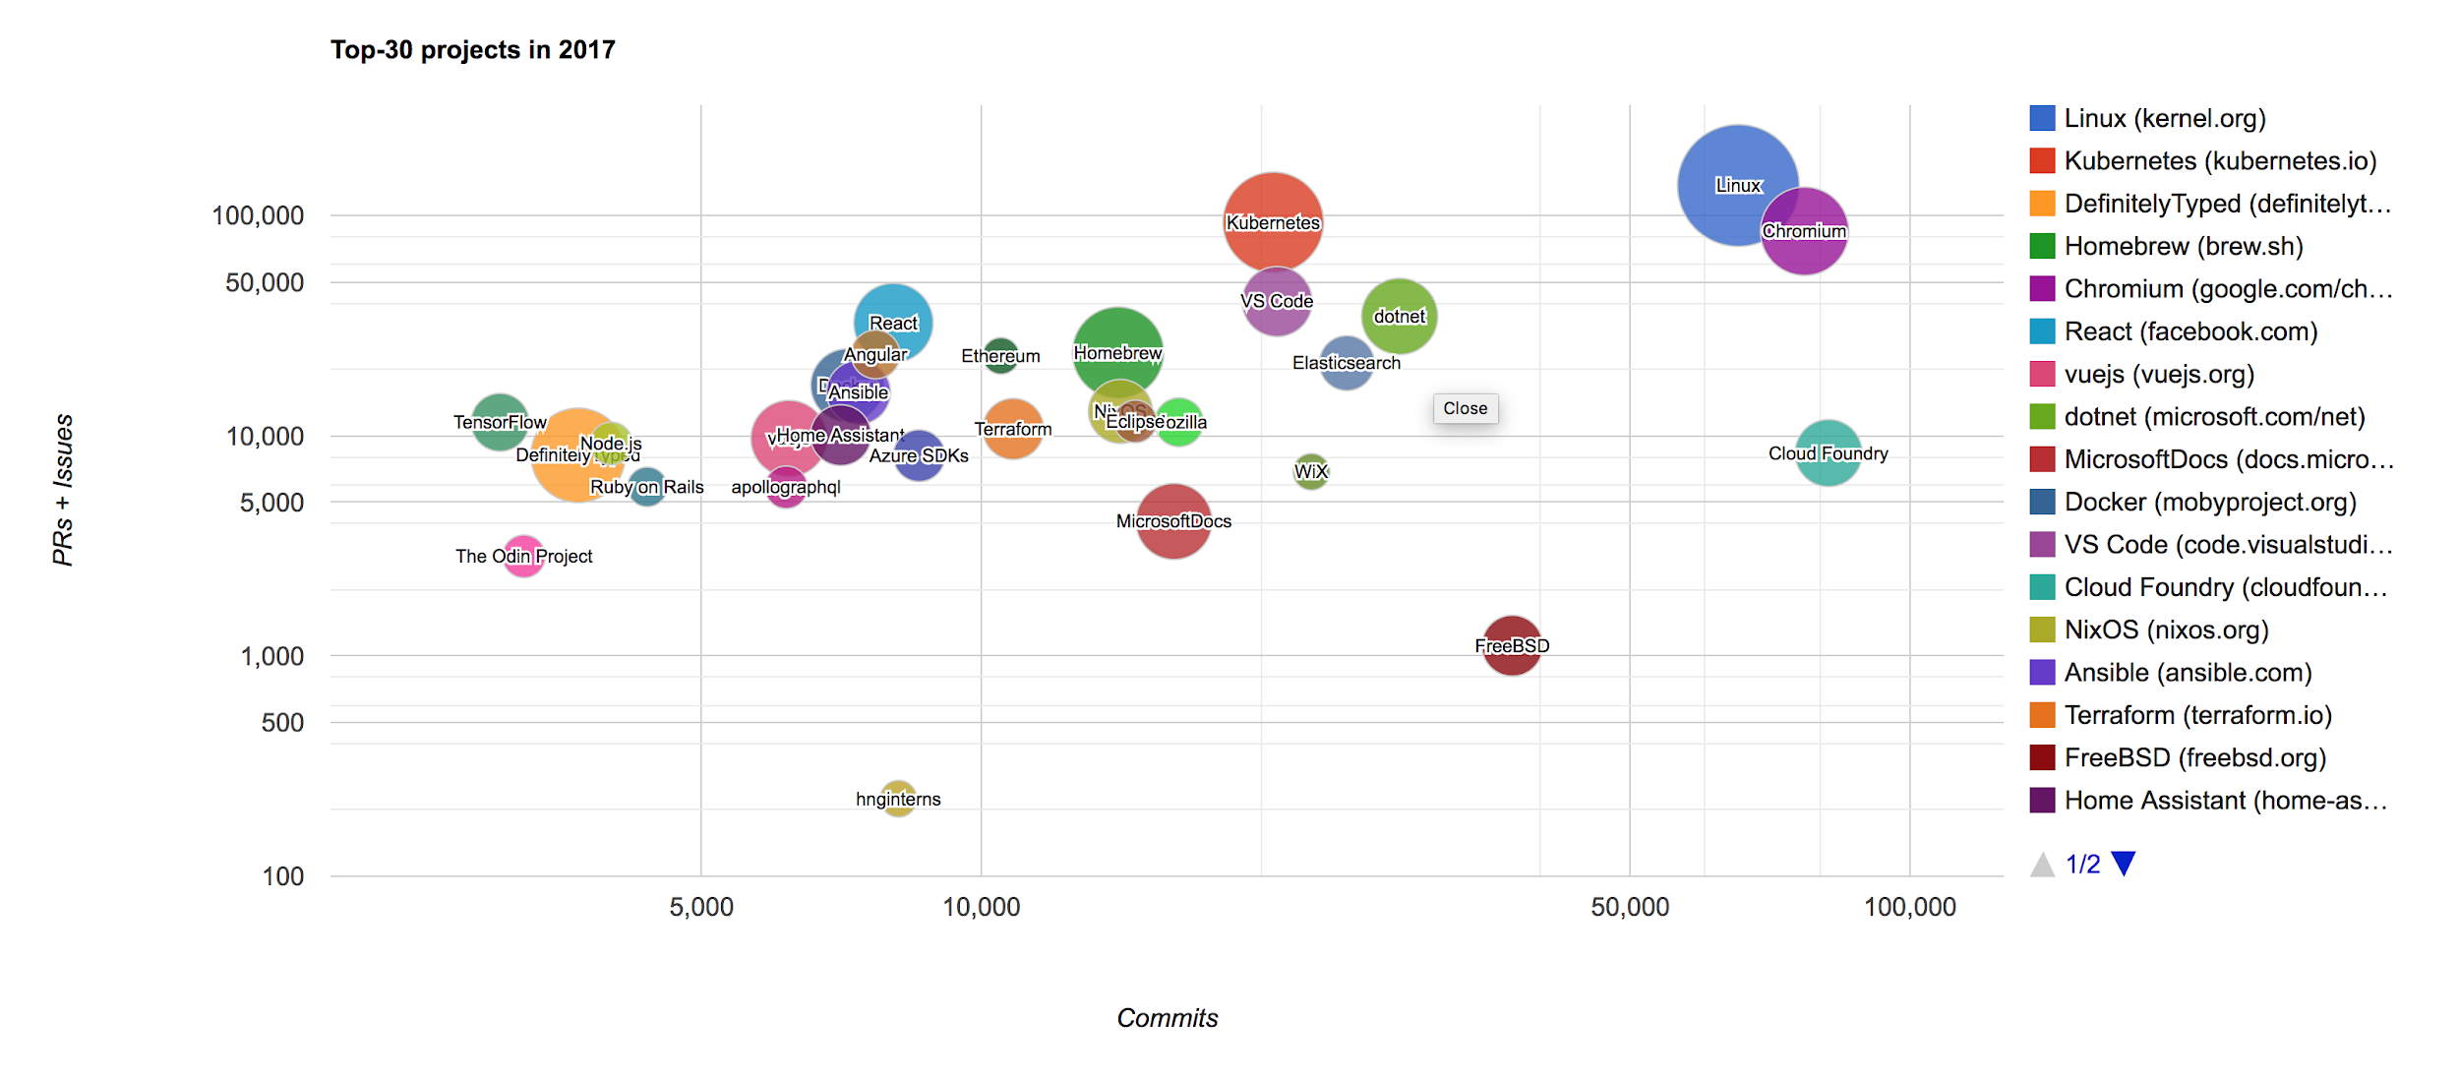
Project Stats
Notes:
Also one of the largest open source projects based on commits and PRs.

Slide 14
A Couple
Key Concepts...
Notes:
There are a few small things we should mention
kind of a chicken and egg problem, need to talk about these before the stuff that supports it

Slide 15
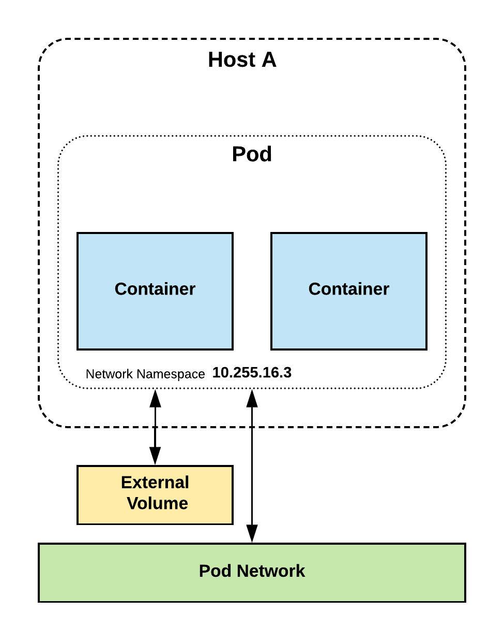
Pods
Atomic unit or smallest “unit of work”of Kubernetes.
Pods are one or MORE containers that share volumes, a network namespace, and are a part of a single context.

Slide 16
Pods
They are
also
Ephemeral!

Slide 17
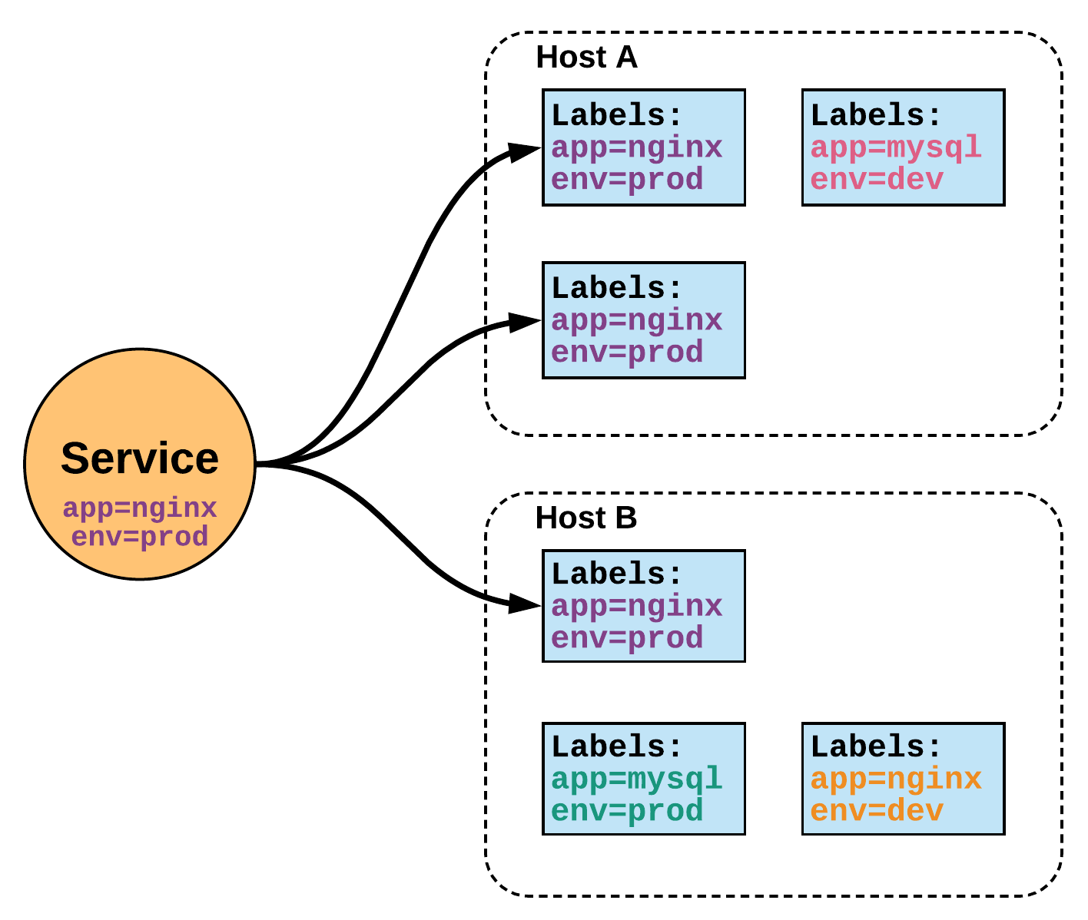
Services
Unified method of accessing the exposed workloads of Pods.
Durable resource
static cluster IP
static namespaced DNS name

Slide 18
Services
Unified method of accessing the exposed workloads of Pods.
Durable resource
static cluster IP
static namespaced DNS name
NOT Ephemeral!

Slide 19
Architecture
Overview
Notes:
Get right into the meat of it

Slide 20
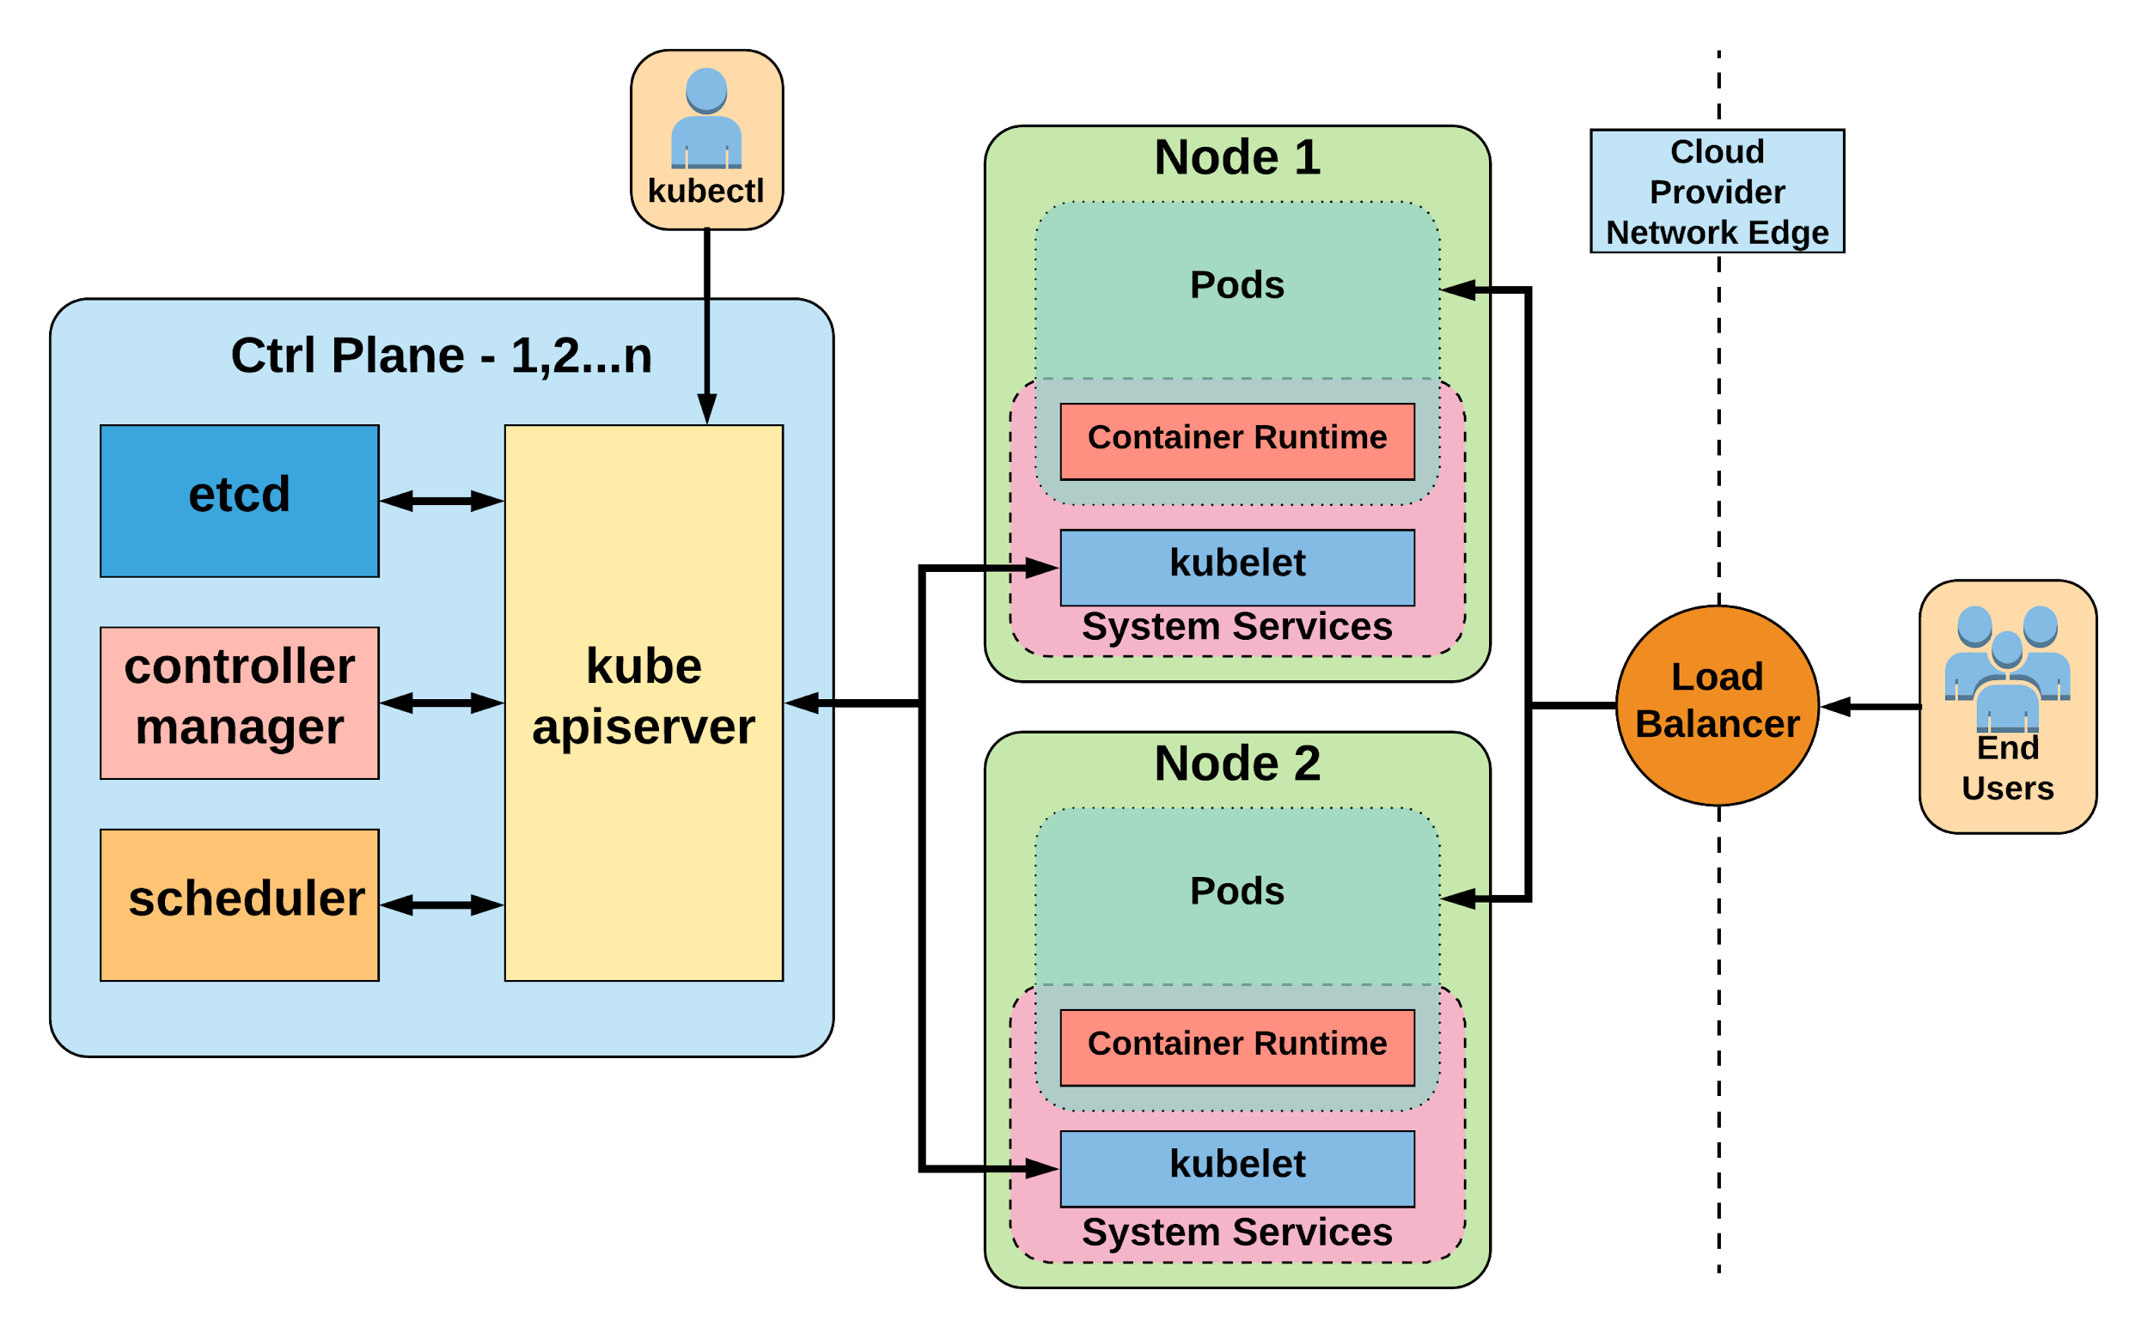
Notes:
General High Level Architecture Overview
There is 1-n number of masters or control plane servers, usually deployed in 1,3,5,7 configurations
Up to 5000 “worker nodes”

Slide 21
Control Plane Components
Architecture Overview

Slide 22
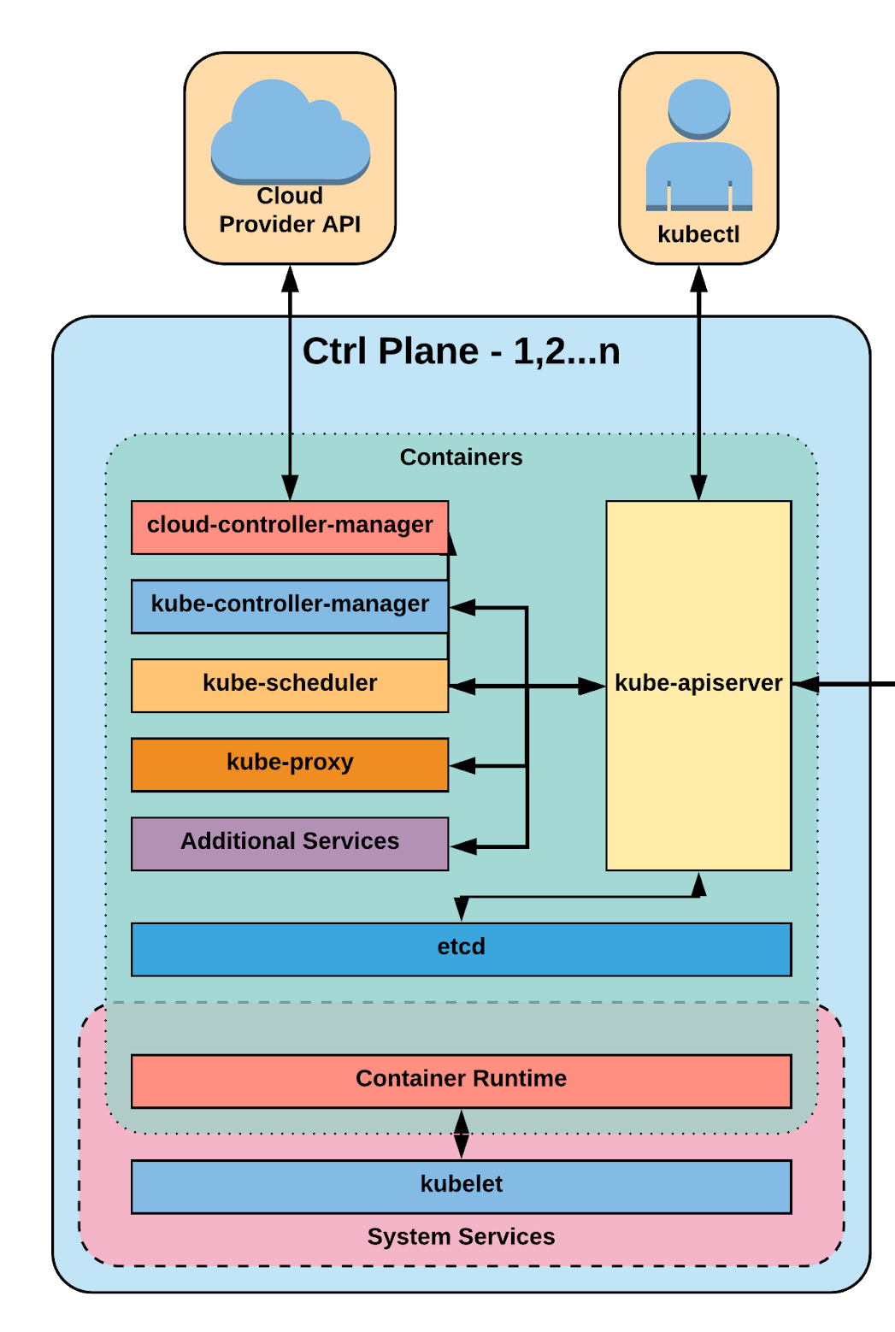
Control Plane Components
kube-apiserver
etcd
kube-controller-manager
kube-scheduler

Slide 23
kube-apiserver
Provides a forward facing REST interface into the kubernetes control plane and datastore.
All clients and other applications interact with kubernetes strictly through the API Server.
Acts as the gatekeeper to the cluster by handling authentication and authorization, request validation, mutation, and admission control in addition to being the front-end to the backing datastore.

Slide 24

etcd
etcd acts as the cluster datastore.
Purpose in relation to Kubernetes is to provide a strong, consistent and highly available key-value store for persisting cluster state.
Stores objects and config information.

Slide 25
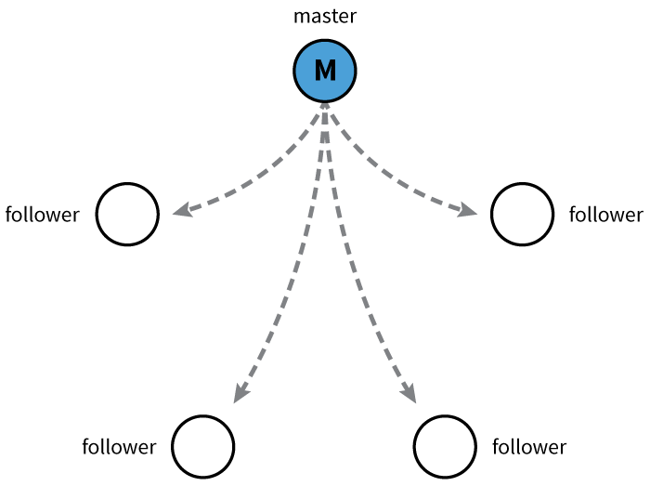
etcd
Uses “Raft Consensus” among a quorum of systems to create a fault-tolerant consistent “view” of the cluster.
https://raft.github.io/
https://www.brianstorti.com/raft/
Image Source
Notes:
provides HA via raft
requires quorum of systems
Raft works by keeping a replicated log
This log is an append-only data structure where new entries are added, and only a single server, the leader, is responsible for managing this log

Slide 26
kube-controller-manager
Serves as the primary daemon that manages all core component control loops.
Monitors the cluster state via the apiserver and steers the cluster towards the desired state.
List of core controllers: https://github.com/kubernetes/kubernetes/blob/master/cmd/kube-controller-manager/app/controllermanager.go#L332
Notes:
Its the director behind the scenes
The thing that says “hey I need a few more pods spun up”
Does NOT handle scheduling, just decides what the desired state of the cluster should look like
e.g. receives request for a deployment, produces replicaset, then produces pods

Slide 27
kube-scheduler
Verbose policy-rich engine that evaluates workload requirements and attempts to place it on a matching resource.
Default scheduler uses bin packing.
Workload Requirements can include: general hardware requirements, affinity/anti-affinity, labels, and other various custom resource requirements.
Notes:
scheduler decides which nodes should run which pods
updates pod with a node assignment, nodes poll checking which pods have their matching assignment
takes into account variety of reqs, affinity, anti-affinity, hw resources etc
possible to actually run more than one scheduler
example: kube-arbiter is batch scheduler based off LSF/Symphony and provides gang-like scheduling

Slide 28
Node
Components
Architecture Overview

Slide 29
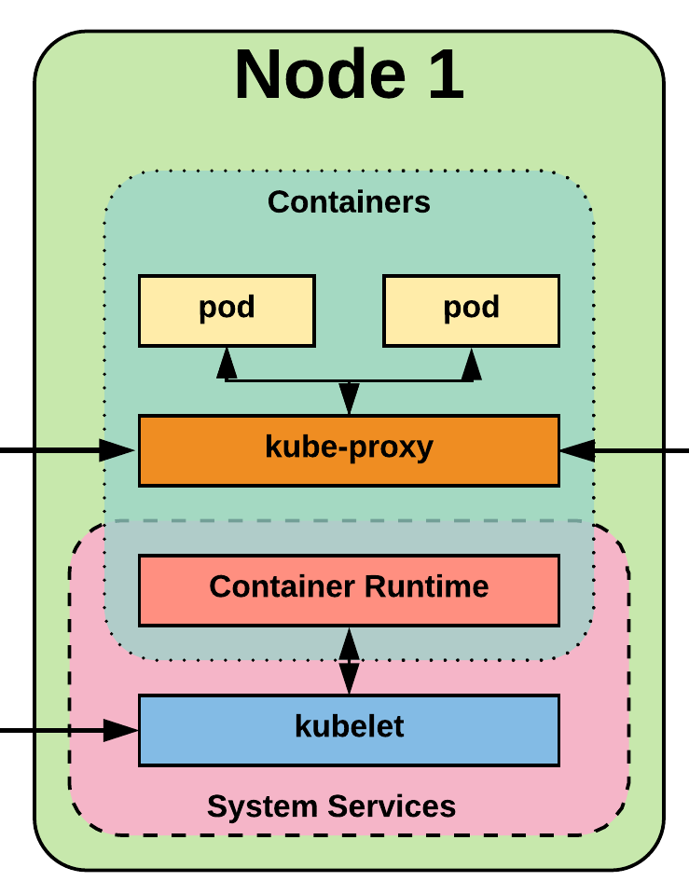
Node Components
kubelet
kube-proxy
Container Runtime Engine

Slide 30
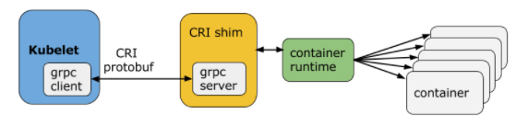
kubelet
Acts as the node agent responsible for managing the lifecycle of every pod on its host.
It receives the Pod definition via various means (primarily, through the API server), and runs the containers associated with the Pod.
It also makes sure that the containers which are part of the Pods are healthy at all times.
Image Source
Notes:
the single host daemon required for a being a part of a kubernetes cluster
can read pod manifests from several different locations
workers: poll kube-apiserver looking for what they should run
masters: run the master services as static manifests found locally on the host
The kubelet connects to the container runtime using Container Runtime Interface (CRI). The Container Runtime Interface consists of protocol buffers, gRPC API, and libraries.

Slide 31
Container Runtime Engine
A container runtime is a CRI (Container Runtime Interface) compatible application that executes and manages containers.
Containerd (docker)
Cri-o
Rkt
Kata (formerly clear and hyper)
Virtlet (VM CRI compatible runtime)
Notes:
Kubernetes functions with multiple different containerizers
Interacts with them through the CRI - container runtime interface
CRI creates a ‘shim’ to talk between kubelet and the container runtime
cri-o is a cool one that allows you to run any oci compatible image/runtime in Kubernetes
kata is a super lightweight KVM wrapper

Slide 32
kube-proxy
Manages the network rules on each node.
Performs connection forwarding or load balancing for Kubernetes cluster services.
Available Proxy Modes:
Userspace
iptables
ipvs (beta in 1.9)
Notes:
kube-proxy is the plumber
creates the rules on the host to map and expose services
iptables is current default, with ipvs becoming the default soon
ipvs is more performant and opens the door to a wider feature set (port ranges, better lb rules etc)
kube-proxy is the network proxy which runs on each worker node and listens to the API server for each Service endpoint creation/deletion. For each Service endpoint, kube-proxy sets up the routes so that it can reach to it.

Slide 33

Notes:
The complete picture

Slide 34
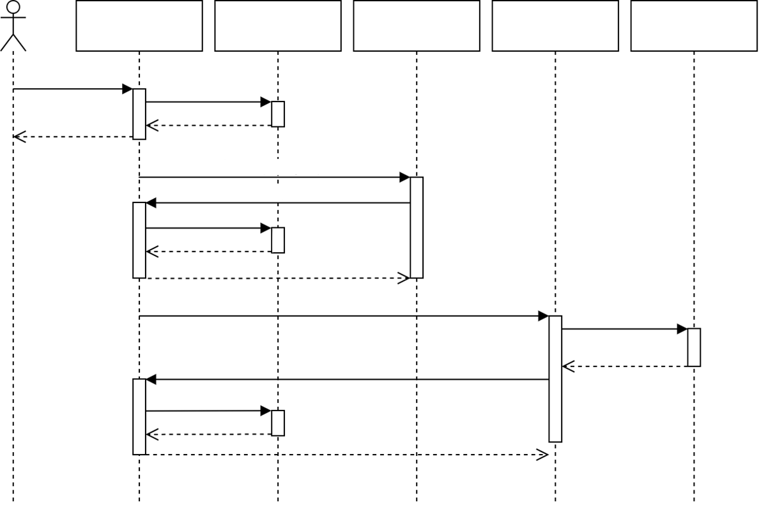
API Server
etcd
Scheduler
Kubelet
Docker
create Pod
write
watch(new pod)
bind pod
write
watch(bound pod)
docker Run
Update pod status
write
Image Source
Notes:
The user creates a Pod via the API Server and the API server writes it to etcd.
The scheduler notices an “unbound” Pod and decides which node to run that Pod on. It writes that binding back to the API Server.
The Kubelet notices a change in the set of Pods that are bound to its node. It, in turn, runs the container via the container runtime (i.e. Docker).
The Kubelet monitors the status of the Pod via the container runtime. As things change, the Kubelet will reflect the current status back to the API Server.

Slide 35
Optional
Services
Architecture Overview
Notes:
“Optional” Services

Slide 36
cloud-controller-manager
Daemon that provides cloud-provider specific knowledge and integration capability into the core control loop of Kubernetes.
The controllers include Node, Route, Service, and add an additional controller to handle things such as PersistentVolume Labels.
Notes:
runs in the control plane
Google, amazon etc all have their own defaults for providing volumes and services to a cluster, this acts as the middle man

Slide 37
Cluster DNS
Provides Cluster Wide DNS for Kubernetes Services.
kube-dns (default 1.10)
CoreDNS (future default)
Notes:
kube-dns is a wrapper around dnsmasq with another container in the pod that manages its config
CoreDNS is a single golang binary with a slew of plugins and much better native kubernetes support

Slide 38
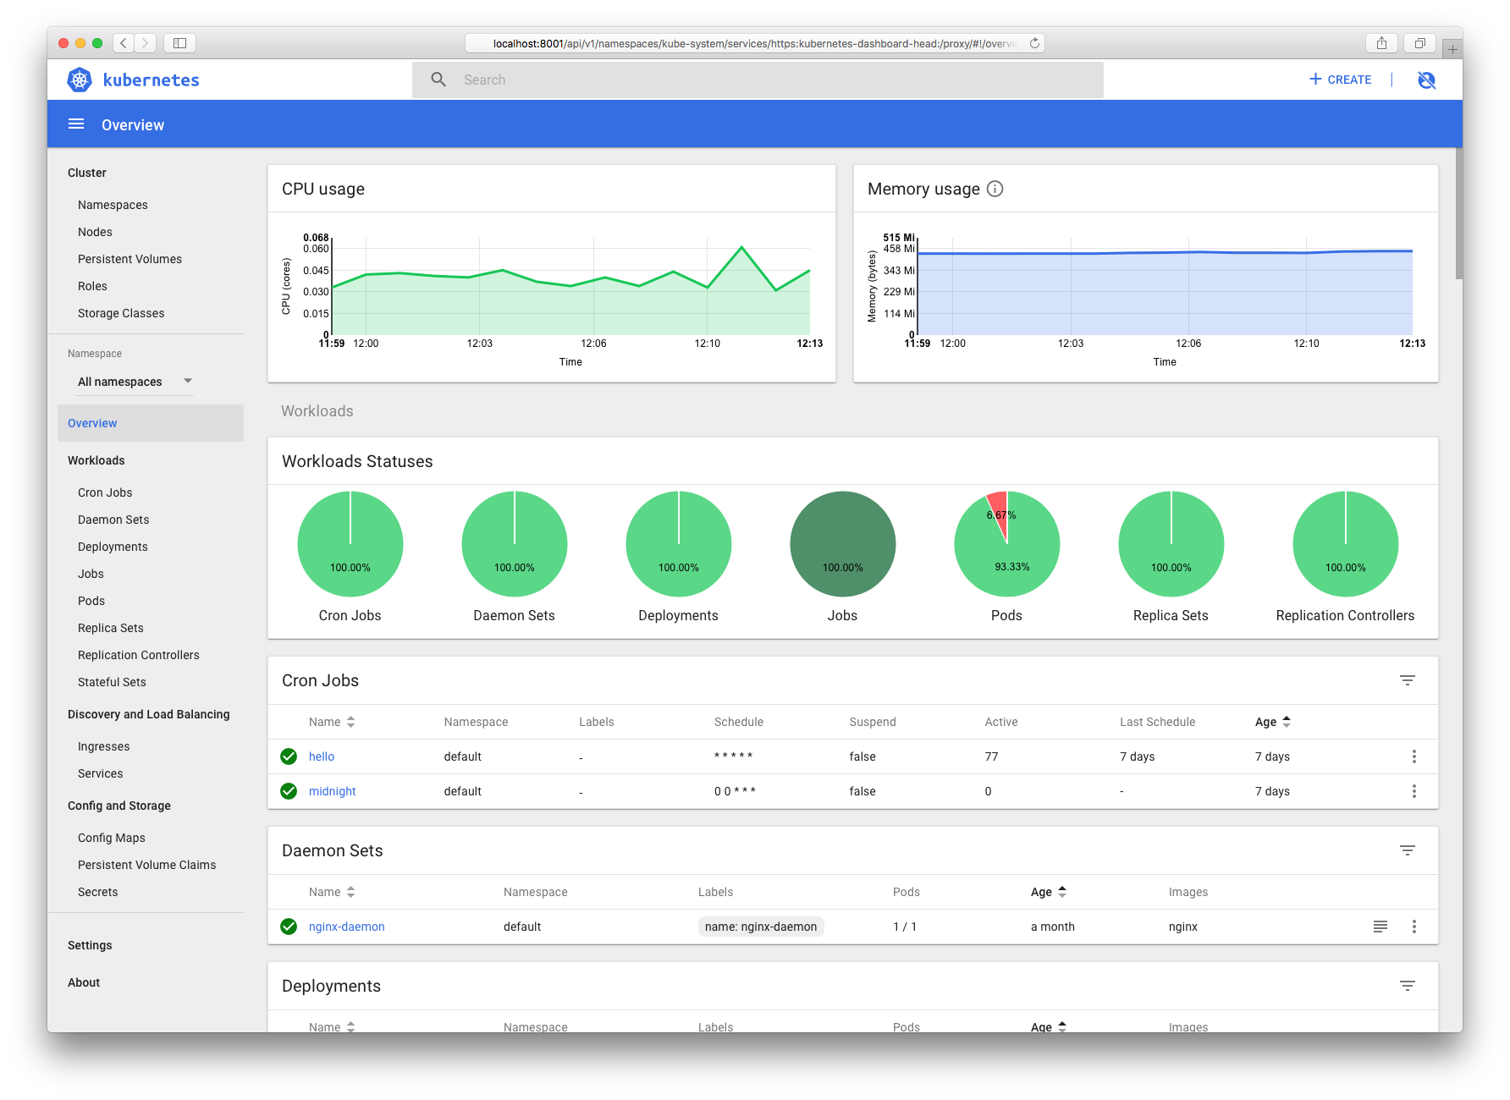
Kube Dashboard
A limited, general purpose web front end for the Kubernetes Cluster.
Notes:
Useful for quickly getting a picture of the cluster, but no substitute for cli or other tools

Slide 39
Heapster / Metrics API Server
Provides metrics for use with other Kubernetes Components.
Heapster (being deprecated)
Metrics API (current)
Notes:
Heapster is being deprecated but can be found in minikube etc
metrics api is taking over
used with horizontal pod autoscaler, kube-dashboard, kubectl etc

Slide 40
Networking
Architecture Overview
Notes:
Networking is where people tend to get confused, they think of it like Docker
The backing cluster network is a plugin, does not work just out of the box

Slide 41
Kubernetes Networking
Pod Network
Cluster-wide network used for pod-to-pod communication managed by a CNI (Container Network Interface) plugin.
Service Network
Cluster-wide range of Virtual IPs managed by kube-proxy for service discovery.
https://kubernetes.io/docs/concepts/cluster-administration/networking/
Notes:
Unlike Docker, every pod gets its own cluster wide unique IP, and makes use of the CNI plugin
Services are a separate range of static non-routable virtual IPs that are used like an internal LB or static IP
Service IPs are special and can’t be treated like a normal IP, they are a ‘mapping’ stored and managed by kube-proxy
Pod IPs are pingable
Service IPs are not

Slide 42

Container Network Interface (CNI)
Pod networking within Kubernetes is plumbed via the Container Network Interface (CNI).
Functions as an interface between the container runtime and a network implementation plugin.
CNCF Project
Uses a simple JSON Schema.
Notes:
Covering this as its a requirement if bootstrapping your own cluster
Container runtime in this context is a linux network namespace
CNI runtime focuses solely on container lifecycle connectivity
add and delete network

Slide 43
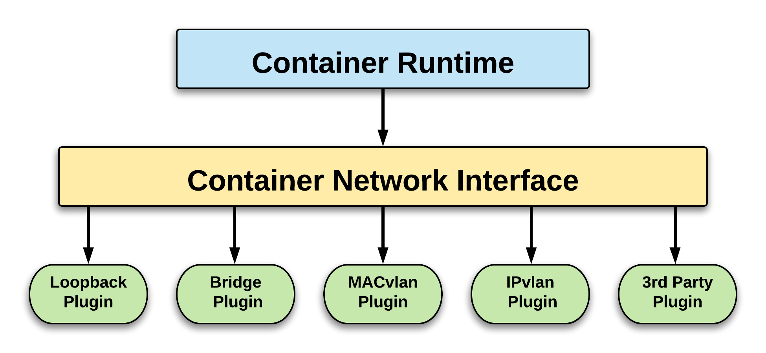
CNI Overview

Slide 44
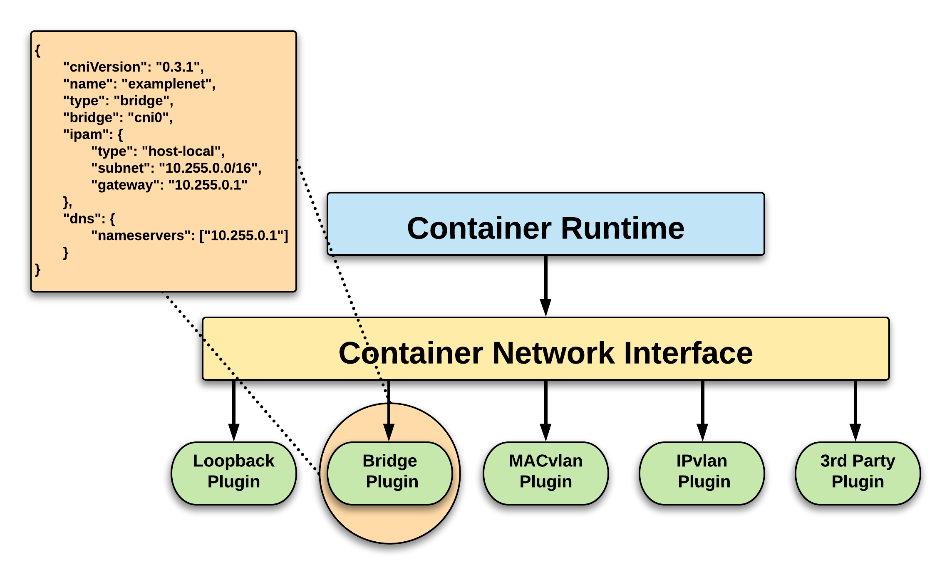
CNI Overview
Notes:
The container runtime offloads the IP assignment to CNI, which connects to the underlying configured plugin, like Bridge or MACvlan, to get the IP address. Once the IP address is given by the respective plugin, CNI forwards it back to the requested container runtime.

Slide 45











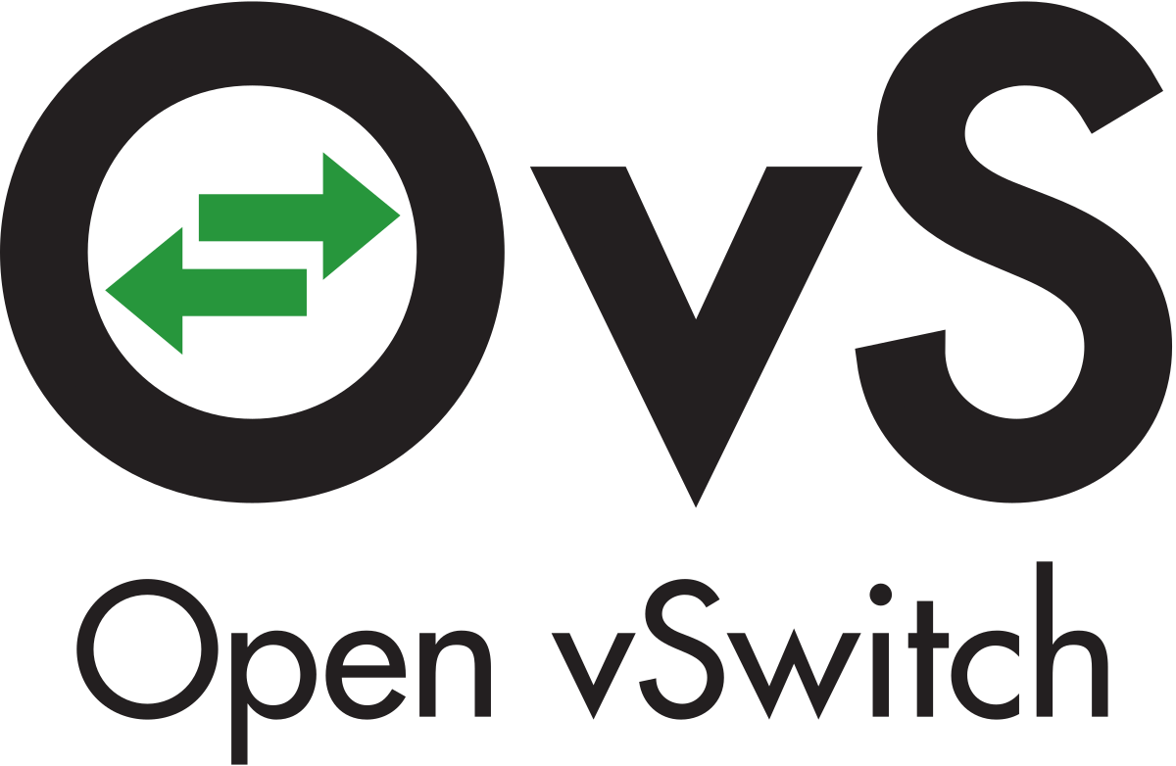
CNI Plugins
Amazon ECS
Calico
Cillium
Contiv
Contrail
Flannel
GCE
kube-router
Multus
OpenVSwitch
Romana
Weave
Notes:
Just a subset, circa Feb 2018

Slide 46
Fundamental Networking Rules
All containers within a pod can communicate with each other unimpeded.
All Pods can communicate with all other Pods without NAT.
All nodes can communicate with all Pods (and vice-versa) without NAT.
The IP that a Pod sees itself as is the same IP that others see it as.
Notes:
Reminder to myself: Don’t expand on things on THIS SLIDE, use the next ones
Kubernetes adheres to these fundamental rules for networking

Slide 47
Fundamentals Applied
Container-to-Container
Containers within a pod exist within the same network namespace and share an IP.
Enables intrapod communication over localhost.
Pod-to-Pod
Allocated cluster unique IP for the duration of its life cycle.
Pods themselves are fundamentally ephemeral.
Notes:
Pods are groups of containers into a single manageable unit
Example: app container + a container within a pod that sends logs to another service
Pods are given a cluster unique IP for the duration of its lifecycle.
Think dhcp, a Pod will be given a static lease for as long as it’s around

Slide 48
Fundamentals Applied
Pod-to-Service
managed by kube-proxy and given a persistent cluster unique IP
exists beyond a Pod’s lifecycle.
External-to-Service
Handled by kube-proxy.
Works in cooperation with a cloud provider or other external entity (load balancer).
Notes:
Both pod-to-service and external-to-service connectivity relies on kube-proxy
For pod-to-service - kubernetes creates a cluster-wide IP that can map to n-number of pods
think like a dns name, or an LB to point to containers backing your service
External Connectivity relies on an external entity, a cloud provider or some other system in conjunction with kube-proxy to map out-of-cluster access to cluster services

Slide 49
Using the API

Slide 50
The API
and Object Model
Concepts and Resources

Slide 51

API Overview
The REST API is the true keystone of Kubernetes.
Everything within the Kubernetes is as an API Object.
Image Source

Slide 52
API Groups
Designed to make it extremely simple to both understand and extend.
An API Group is a REST compatible path that acts as the type descriptor for a Kubernetes object.
Referenced within an object as the apiVersion and kind.
Format:
/apis/<group>/<version>/<resource>
Examples:
/apis/apps/v1/deployments
/apis/batch/v1beta1/cronjobs
Notes:
Every object in kubernetes belongs to an API Group
The API Group is a REST compatible path that acts as the type descriptor for a Kubernetes object.
apiVersion is the version of the object we’re creating
kind is the specific type of object or resource being created

Slide 53
API Versioning
Three tiers of API maturity levels.
Also referenced within the object apiVersion.
Alpha: Possibly buggy, And may change. Disabled by default.
Beta: Tested and considered stable. However API Schema may change. Enabled by default.
Stable: Released, stable and API schema will not change. Enabled by default.
Format:
/apis/<group>/<version>/<resource>
Examples:
/apis/apps/v1/deployments
/apis/batch/v1beta1/cronjobs
Notes:
Note on how to enable disabled (alpha) features

Slide 54
Object Model
Objects are a “record of intent” or a persistent entity that represent the desired state of the object within the cluster.
All objects MUST have apiVersion, kind, and poses the nested fields metadata.name, metadata.namespace, and metadata.uid.
Notes:
Record of intent - If you order pizza for delivery, you have specified clearly what you want delivered.
These attributes establish the type of object, the version of the object and a unique identity for the object itself
HOWEVER when defining an object, many fields are optional (namespace can be inherited. UID can be generated)

Slide 55
Object Model Requirements
apiVersion: Kubernetes API version of the Object
kind: Type of Kubernetes Object
metadata.name: Unique name of the Object
metadata.namespace: Scoped environment name that the object belongs to (will default to current).
metadata.uid: The (generated) uid for an object.
apiVersion: v1
kind: Pod
metadata:
name: pod-example namespace: default
uid: f8798d82-1185-11e8-94ce-080027b3c7a6

Slide 56
Object Expression - YAML
Files or other representations of Kubernetes Objects are generally represented in YAML.
A “Human Friendly” data serialization standard.
Uses white space (specifically spaces) alignment to denote ownership.
Three basic data types:
mappings - hash or dictionary,
sequences - array or list
scalars - string, number, boolean etc
Notes:
YAML Ain't Markup Language
“Human friendly”....till things get complicated

Slide 57
Object Expression - YAML
apiVersion: v1
kind: Pod
metadata:
name: yaml
spec:
containers:
- name: container1
image: nginx
- name: container2
image: alpine
Notes:
Super simple example

Slide 58
Object Expression - YAML
apiVersion: v1
kind: Pod
metadata:
name: yaml
spec:
containers:
- name: container1
image: nginx
- name: container2
image: alpine
Scalar
Mapping Hash Dictionary
Sequence Array List

Slide 59
YAML vs JSON
apiVersion: v1
kind: Pod
metadata:
name: pod-example
spec:
containers:
- name: nginx
image: nginx:stable-alpine
ports:
- containerPort: 80
{
"apiVersion": "v1",
"kind": "Pod",
"metadata": {
"name": "pod-example"
},
"spec": {
"containers": [
{
"name": "nginx",
"image": "nginx:stable-alpine",
"ports": [ { "containerPort": 80 } ]
}
]
}
}

Slide 60
Object Model - Workloads
Workload related objects within Kubernetes have an additional two nested fields spec and status.
spec - Describes the desired state or configuration of the object to be created.
status - Is managed by Kubernetes and describes the actual state of the object and its history.

Slide 61
Workload Object Example
Example Object
apiVersion: v1
kind: Pod
metadata:
name: pod-example
spec:
containers:
- name: nginx
image: nginx:stable-alpine
ports:
- containerPort: 80
Example Status Snippet
status:
conditions:
- lastProbeTime: null
lastTransitionTime: 2018-02-14T14:15:52Z
status: "True"
type: Ready
- lastProbeTime: null
lastTransitionTime: 2018-02-14T14:15:49Z
status: "True"
type: Initialized
- lastProbeTime: null
lastTransitionTime: 2018-02-14T14:15:49Z
status: "True"
type: PodScheduled

Slide 62
Exploring
the Core
aka, the almighty kubectl

Slide 63
Namespaces
Pods
Labels
Selectors
Services
Core
Objects
Concepts and Resources

Slide 64
Core Concepts
Kubernetes has several core building blocks that make up the foundation of their higher level components.
Namespaces
Pods
Services
Labels
Selectors

Slide 65
Default Namespaces
default: The default namespace for any object without a namespace.
$
kubectl get namespaces --show-labels
NAME STATUS AGE LABELS
default Active 11h <none>
kube-public Active 11h <none>
kube-system Active 11h <none>
kube-system: Acts as
$
the home for objects and resources created by Kubernetes itself.
kube-public: A special namespace; readable by all users that is reserved for cluster bootstrapping and configuration.
Notes:
Kube-system is not exclusive and can have other things placed in it

Slide 66
Namespaces
Namespaces are a logical cluster or environment, and are the primary method of partitioning a cluster or scoping access.
apiVersion: v1
kind: Namespace
metadata:
name: prod
labels:
app: MyBigWebApp
$
kubectl create -f namespace.yaml
namespace "prod" created
$
kubectl get ns --show-labels
NAME STATUS AGE LABELS
default Active 11h <none>
kube-public Active 11h <none>
kube-system Active 11h <none>
prod Active 6s app=MyBigWebApp
$
namespace.yaml
Notes:
Think like a scope or even a subdomain

Slide 67
Pod
Atomic unit or smallest “unit of work”of Kubernetes.
Foundational building block of Kubernetes Workloads.
Pods are one or more containers that share volumes, a network namespace, and are a part of a single context.

Slide 68
Pod Examples
apiVersion: v1
kind: Pod
metadata:
name: pod-example
spec:
containers:
- name: nginx
image: nginx:stable-alpine
ports:
- containerPort: 80
apiVersion: v1
kind: Pod
metadata:
name: multi-container-example
spec:
containers:
- name: nginx
image: nginx:stable-alpine
volumeMounts:
- name: html
mountPath: /usr/share/nginx/html
- name: content
image: alpine:latest
command: ["/bin/sh", "-c"]
args:
- while true; do
date >> /html/index.html;
sleep 5;
done
volumeMounts:
- name: html
mountPath: /html
volumes:
- name: html
emptyDir: {}
Notes:
discuss sidecar pattern

Slide 69
Key Pod Container Attributes
name - The name of the container
image - The container image
ports - array of ports to expose. Can be granted a friendly name and protocol may be specified
env - array of environment variables
command - Entrypoint array (equiv to Docker ENTRYPOINT)
args - Arguments to pass to the command (equiv to Docker CMD)
Container
name: nginx
image: nginx:stable-alpine
ports:
- containerPort: 80
name: http
protocol: TCP
env:
- name: MYVAR
value: isAwesome
command: [“/bin/sh”, “-c”]
args: [“echo ${MYVAR}”]

Slide 70
Naked Pods
Naked Pods will not be rescheduled in the event of a node failure.
apiVersion: v1
kind: Pod
metadata:
name: pod-example
spec:
containers:
- name: nginx
image: nginx:stable-alpine
ports:
- containerPort: 80
$
kubectl apply -f pod-example.yaml
pod "pod-example" created
$
kubectl get pods
NAME READY STATUS RESTARTS AGE
pod-example 1/1 Running 0 4s
$
kubectl delete pod pod-example
pod "pod-example" deleted
$
kubectl get pods
No resources found.
$
https://stackoverflow.com/questions/47369351/kubectl-apply-vs-kubectl-create
Notes:
Think like a scope or even a subdomain

Slide 71
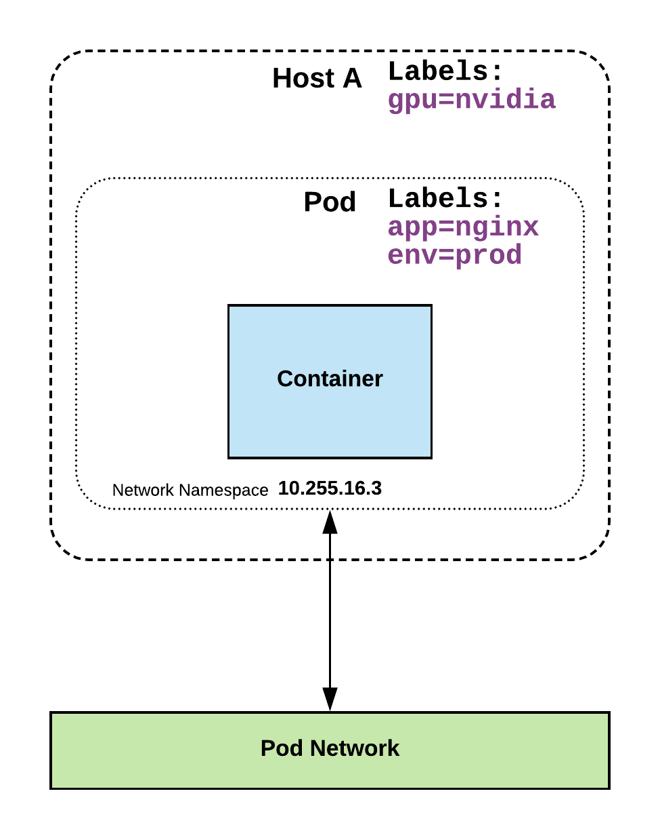
Labels
key-value pairs that are used to identify, describe and group together related sets of objects or resources.
NOT characteristic of uniqueness.
Have a strict syntax with a slightly limited character set*.
* https://kubernetes.io/docs/concepts/overview/working-with-objects/labels/#syntax-and-character-set

Slide 72
Label Example
apiVersion: v1
kind: Pod
metadata:
name: pod-label-example
labels: app: nginx env: prod
spec:
containers:
- name: nginx
image: nginx:stable-alpine
ports:
- containerPort: 80

Slide 73
Selectors
Selectors use labels to filter or select objects, and are used throughout Kubernetes.
apiVersion: v1
kind: Pod
metadata:
name: pod-label-example
labels: app: nginx env: prod
spec:
containers:
- name: nginx
image: nginx:stable-alpine
ports:
- containerPort: 80 nodeSelector:
gpu: nvidia

Slide 74
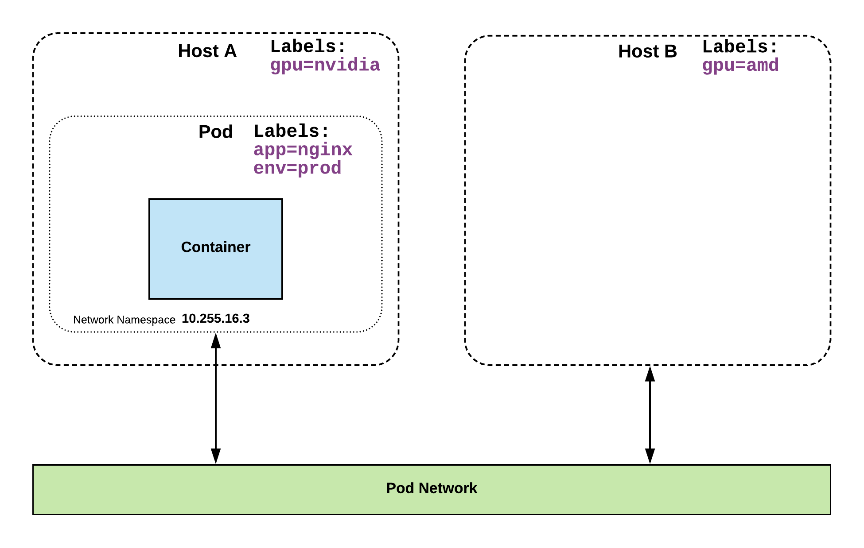
Selector Example
apiVersion: v1
kind: Pod
metadata:
name: pod-label-example
labels: app: nginx env: prod
spec:
containers:
- name: nginx
image: nginx:stable-alpine
ports:
- containerPort: 80 nodeSelector:
gpu: nvidia

Slide 75
Selector Types
Equality based selectors allow for simple filtering (=,==, or !=).
Set-based selectors are supported on a limited subset of objects. However, they provide a method of filtering on a set of values, and supports multiple operators including: in, notin, and exist.
selector:
matchLabels:
gpu: nvidia
selector:
matchExpressions:
- key: gpu
operator: in
values: [“nvidia”]

Slide 76
Services
Unified method of accessing the exposed workloads of Pods.
Durable resource (unlike Pods)
static cluster-unique IP
static namespaced DNS name
<service name>.<namespace>.svc.cluster.local

Slide 77
Services
Target Pods using equality based selectors.
Uses kube-proxy to provide simple load-balancing.
kube-proxy acts as a daemon that creates local entries in the host’s iptables for every service.
Notes:
This in-turn acts as a simple round-robin load balancer among the Pods targeted by the selector.
More options coming

Slide 78
Service Types
There are 4 major service types:
ClusterIP (default)
NodePort
LoadBalancer
ExternalName

Slide 79
ClusterIP Service
ClusterIP services exposes a service on a strictly cluster internal virtual IP.
apiVersion: v1
kind: Service
metadata:
name: example-prod
spec:
selector:
app: nginx
env: prod
ports:
- protocol: TCP
port: 80
targetPort: 80
$
kubectl apply -f service-example-prod.yaml
service "example-prod" created
$
kubectl get services
NAME TYPE CLUSTER-IP EXTERNAL-IP PORT(S) AGE
example-prod ClusterIP 10.31.243.75 <none> 80/TCP 3s
kubernetes ClusterIP 10.31.240.1 <none> 443/TCP 17d
$

Slide 80
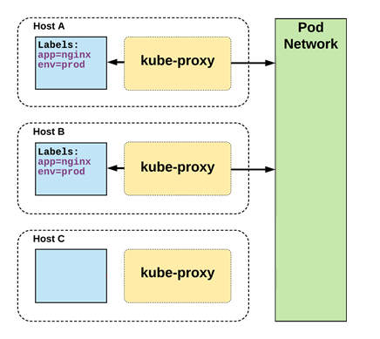
Cluster IP Service
/ #
curl http://example-prod
$
kubectl describe svc example-prod
<!DOCTYPE html>
<html>
<head>
<title>Welcome to nginx!</title>
<style>
body {
width: 35em;
margin: 0 auto;
font-family: Tahoma, Verdana, Arial, sans-serif;
}
</style>
</head>
<body>
<h1>Welcome to nginx!</h1>
<p>If you see this page, the nginx web server is successfully installed and
working. Further configuration is required.</p>
<p>For online documentation and support please refer to
<a href="http://nginx.org/">nginx.org</a>.<br/>
Commercial support is available at
<a href="http://nginx.com/">nginx.com</a>.</p>
<p><em>Thank you for using nginx.</em></p>
</body>
</html>
Name: example-prod
Namespace: default
Labels: <none>
Annotations: ....
Selector: app=nginx,env=prod
Type: ClusterIP
IP: 10.27.243.75
Port: <unset> 80/TCP
TargetPort: 80/TCP
Endpoints: 10.28.2.160:80,10.24.8.143:80
Session Affinity: None
Events: <none>
$
kubectl exec –it test-pod /bin/sh
/ #
nslookup example-prod.default.svc.cluster.local
Name: example-prod.default.svc.cluster.local
Address 1: 10.31.243.75 example-prod.default.svc.cluster.local
test-pod
/ #
clear
/ #

Slide 81
NodePort Service
NodePort services extend the ClusterIP service.
Exposes a port on every node’s IP.
Port can either be statically defined, or dynamically taken from a range between 30000-32767.
apiVersion: v1
kind: Service
metadata:
name: example-prod
spec:
type: NodePort
selector:
app: nginx
env: prod
ports:
- nodePort: 32410
protocol: TCP
port: 80
targetPort: 80

Slide 82
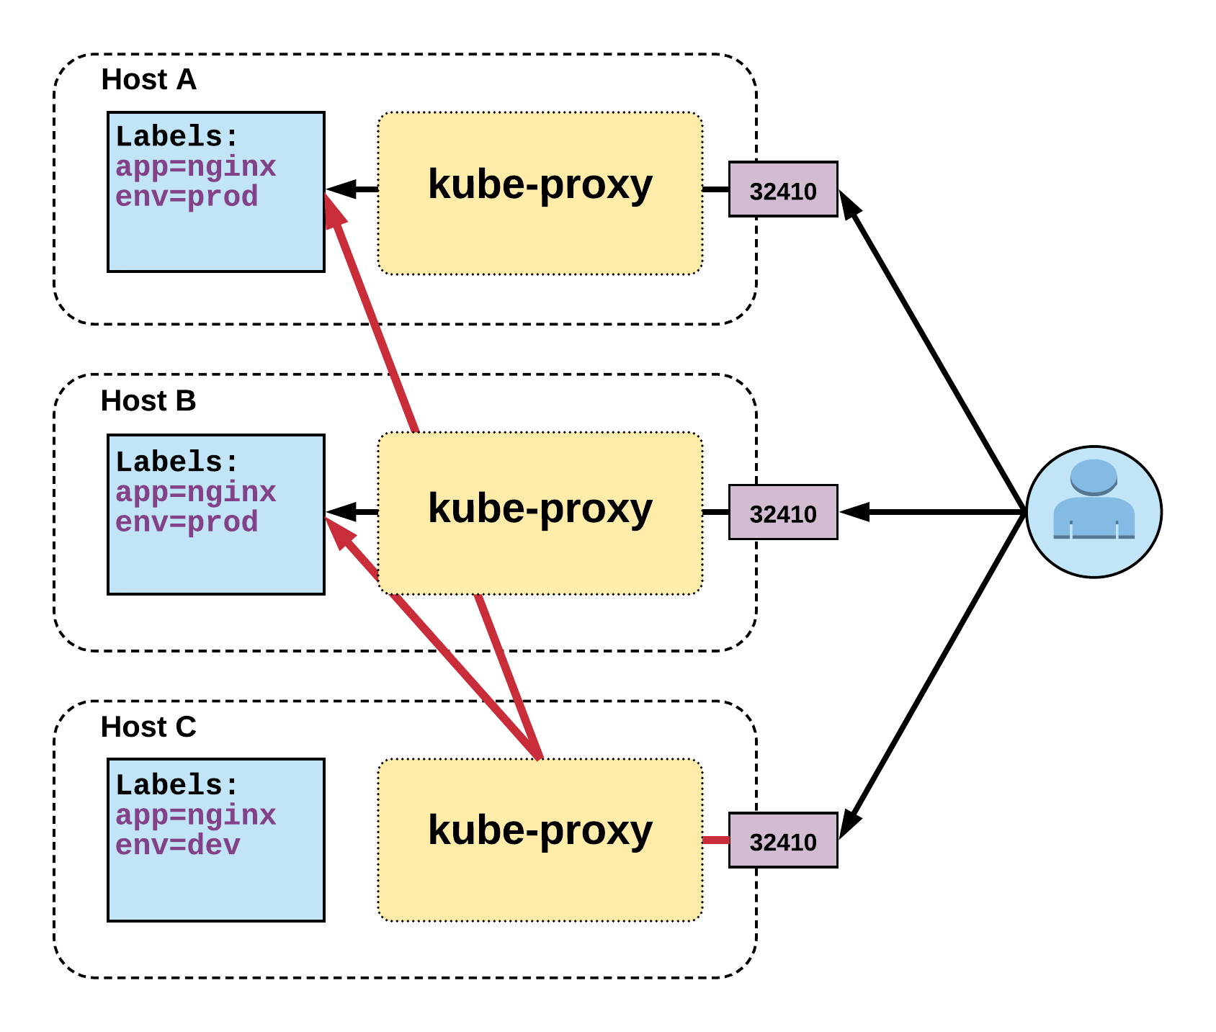
NodePort Service
Name: example-prod
Selector: app=nginx,env=prod
Type: NodePort
IP: 10.96.28.176
Port: <unset> 80/TCP
TargetPort: 80/TCP
NodePort: <unset> 32410/TCP
Endpoints: 10.255.16.3:80, 10.255.16.4:80

Slide 83
LoadBalancer Service
LoadBalancer services extend NodePort.
Works in conjunction with an external system to map a cluster external IP to the exposed service.
apiVersion: v1
kind: Service
metadata:
name: example-prod
spec:
type: LoadBalancer
selector:
app: nginx
env: prod
ports:
protocol: TCP
port: 80
targetPort: 80
Bare Metal: https://github.com/google/metallb

Slide 84
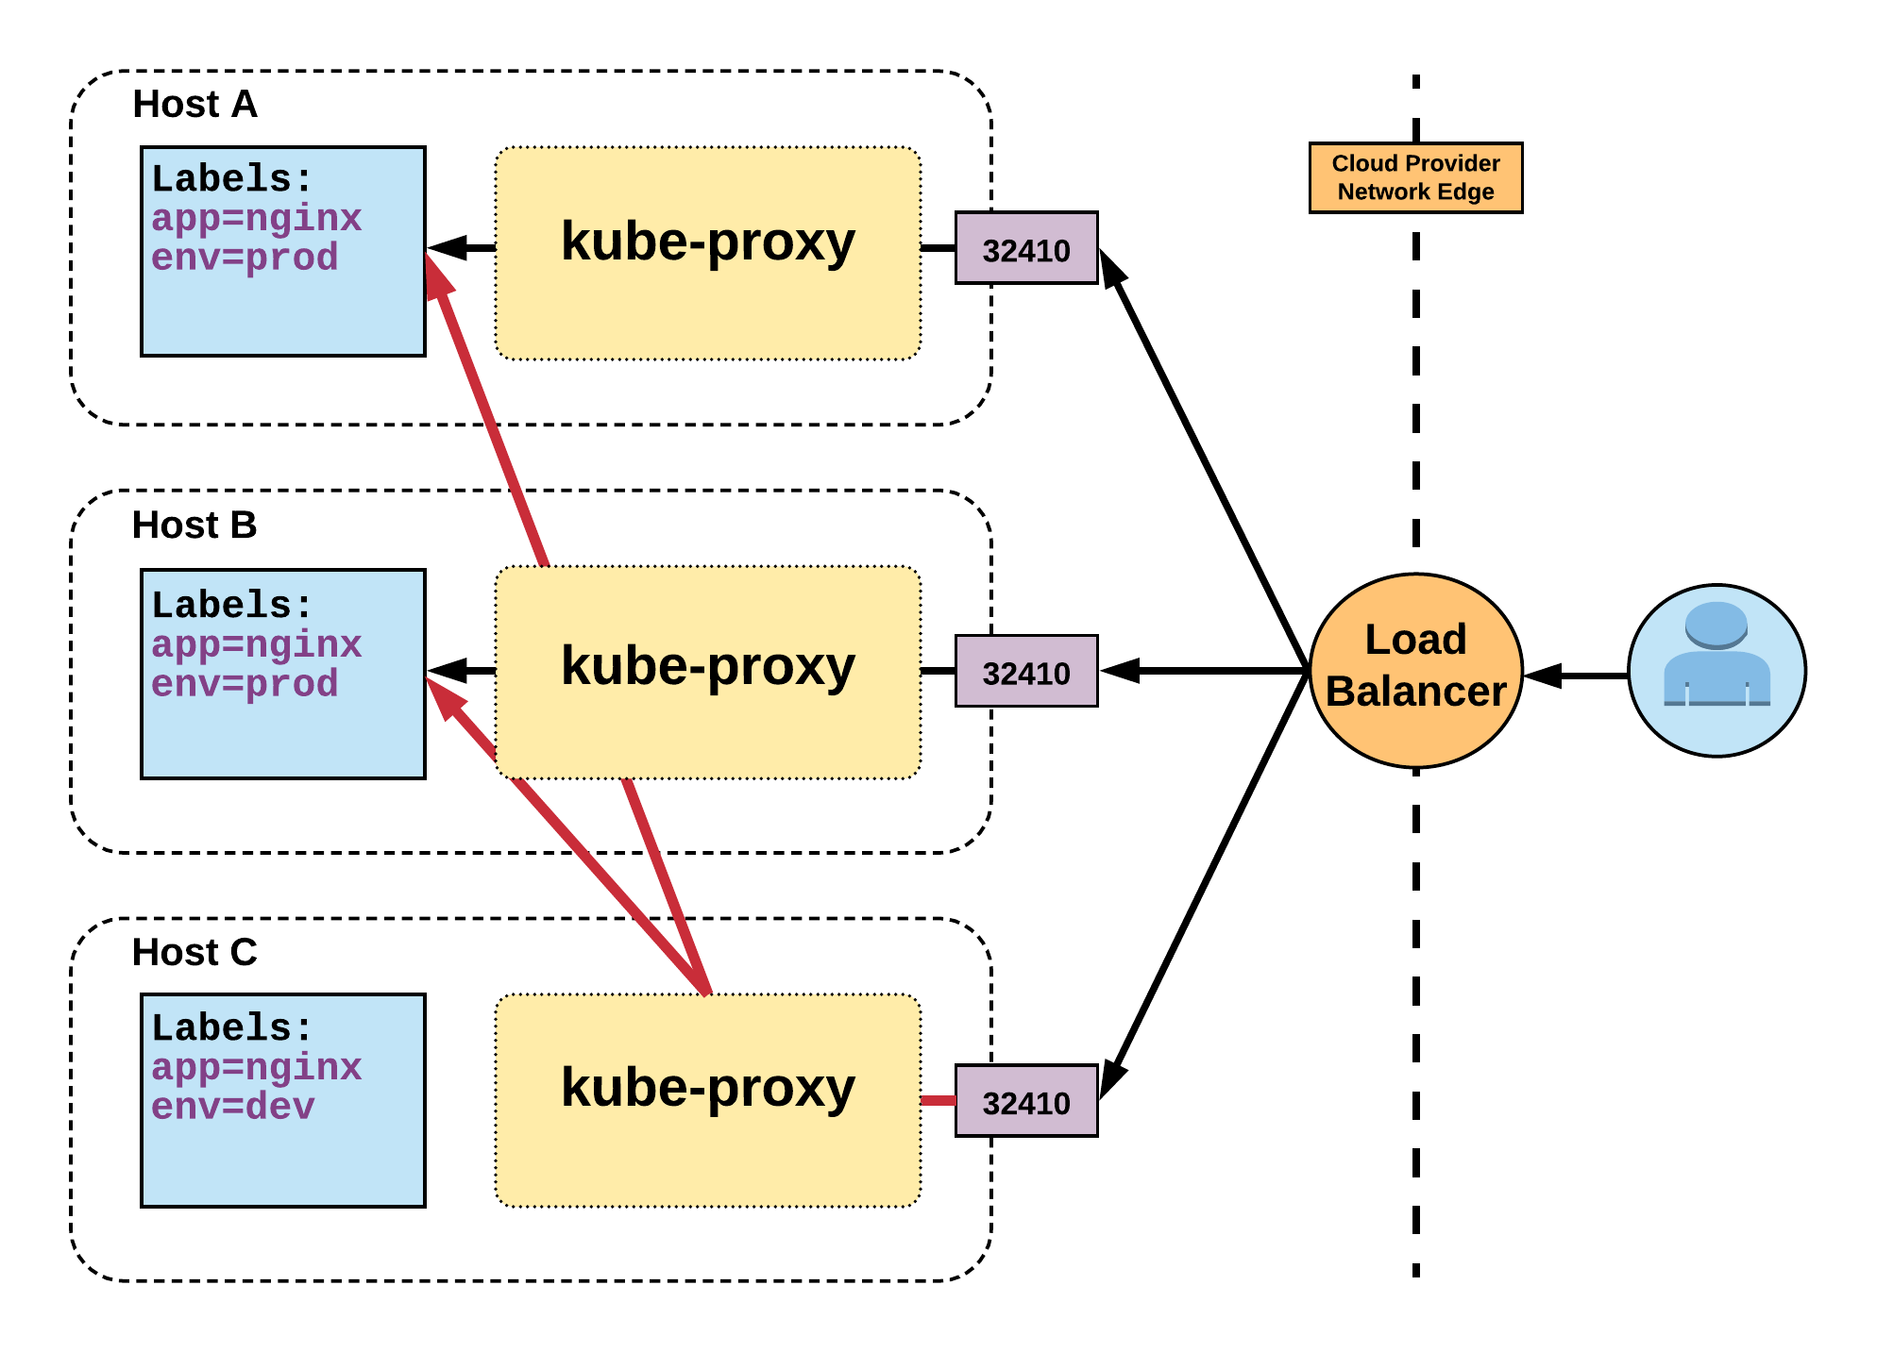
LoadBalancer Service
Name: example-prod
Selector: app=nginx,env=prod
Type: LoadBalancer
IP: 10.96.28.176
LoadBalancer Ingress: 172.17.18.43
Port: <unset> 80/TCP
TargetPort: 80/TCP
NodePort: <unset> 32410/TCP
Endpoints: 10.255.16.3:80, 10.255.16.4:80

Slide 85
ExternalName Service
ExternalName is used to reference endpoints OUTSIDE the cluster.
Creates an internal CNAME DNS entry that aliases another.
apiVersion: v1
kind: Service
metadata:
name: example-prod
spec:
type: ExternalName
spec:
externalName: example.com
Notes:
Allows you to point your configs and such to a static entry internally that you can update out of band later

Slide 86
Using Workloads

Slide 87
ReplicaSet
Deployment
DaemonSet
StatefulSet
Job
CronJob
Workloads
Concepts and Resources

Slide 88
Workloads
Workloads within Kubernetes are higher level objects that manage Pods or other higher level objects.
In ALL CASES a Pod Template is included, and acts the base tier of management.

Slide 89
Pod Template
Workload Controllers manage instances of Pods based off a provided template.
Pod Templates are Pod specs with limited metadata.
Controllers use Pod Templates to make actual pods.
apiVersion: v1
kind: Pod
metadata:
name: pod-example
labels: app: nginx
spec:
containers:
- name: nginx
image: nginx
template:
metadata:
labels: app: nginx
spec:
containers:
- name: nginx
image: nginx

Slide 90
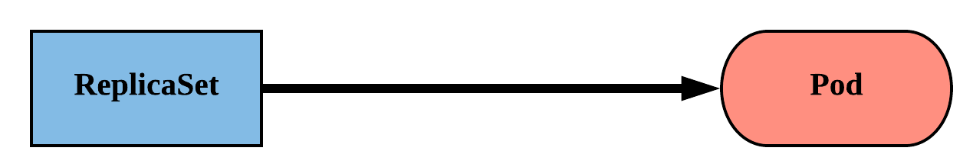
ReplicaSet
Primary method of managing pod replicas and their lifecycle.
Includes their scheduling, scaling, and deletion.
Their job is simple: Always ensure the desired number of pods are running.

Slide 91
ReplicaSet
replicas: The desired number of instances of the Pod.
selector:The label selector for the ReplicaSet will manage ALL Pod instances that it targets; whether it’s desired or not.
apiVersion: apps/v1
kind: ReplicaSet
metadata:
name: rs-example
spec:
replicas: 3
selector:
matchLabels:
app: nginx env: prod
template:
<pod template>

Slide 92
ReplicaSet
apiVersion: apps/v1
kind: ReplicaSet
metadata:
name: rs-example
spec:
replicas: 3
selector:
matchLabels:
app: nginx env: prod
template:
metadata:
labels:
app: nginx
env: prod
spec:
containers:
- name: nginx
image: nginx:stable-alpine
ports:
- containerPort: 80
$
kubectl get pods
NAME READY STATUS RESTARTS AGE
rs-example-9l4dt 1/1 Running 0 1h
rs-example-b7bcg 1/1 Running 0 1h
rs-example-mkll2 1/1 Running 0 1h
$
kubectl describe rs rs-example
Name: rs-example
Namespace: default
Selector: app=nginx,env=prod
Labels: app=nginx
env=prod
Annotations: <none>
Replicas: 3 current / 3 desired
Pods Status: 3 Running / 0 Waiting / 0 Succeeded / 0 Failed
Pod Template:
Labels: app=nginx
env=prod
Containers:
nginx:
Image: nginx:stable-alpine
Port: 80/TCP
Environment: <none>
Mounts: <none>
Volumes: <none>
Events:
Type Reason Age From Message
---- ------ ---- ---- -------
Normal SuccessfulCreate 16s replicaset-controller Created pod: rs-example-mkll2
Normal SuccessfulCreate 16s replicaset-controller Created pod: rs-example-b7bcg
Normal SuccessfulCreate 16s replicaset-controller Created pod: rs-example-9l4dt

Slide 93
ReplicaSet
$
kubectl create -f rs-example.yaml
Pod:
rs-example-q3vkg
Pod:
rs-example-k0xz6
Replicaset.apps "rs-example" created
app: ngnix
app: ngnix
$
kubectl get pods
NAME READY STATUS RESTARTS AGE
rs-example-53thy 0/1 ContainerCreating 0 2s
rs-example-k0xz6 0/1 ContainerCreating 0 2s
rs-example-q3vkg 0/1 ContainerCreating 0 2s
$
kubectl delete pod rs-example-53thy
Pod:
rs-example-oini2
Pod:
rs-example-53thy
app: ngnix
app: ngnix
pod "rs-example-53thy" deleted
$
kubectl get pods
NAME READY STATUS RESTARTS AGE
rs-example-53thy 1/1 Terminating 0 3m
rs-example-oini2 0/1 ContainerCreating 0 2s
rs-example-k0xz6 1/1 Running 0 3m
rs-example-q3vkg 1/1 Running 0 3m
[ContainerCreating]
[Terminating]
ReplicaSet: rs-example
Replicas: 3
Selector: app=ngnix
$
kubectl get rs
NAME DESIRED CURRENT READY AGE
rs-example 3 3 2 3m

Slide 94
ReplicaSet
$
kubectl scale replicaset rs-example --replicas=5
Pod:
rs-example-q3vkg
Pod:
rs-example-k0xz6
replicaset.extensions "rs-example" scaled
app: ngnix
app: ngnix
$
kubectl get pods
NAME READY STATUS RESTARTS AGE
rs-example-7msqg 1/1 Running 0 8s
rs-example-oini2 1/1 Running 0 5m
rs-example-k0xz6 1/1 Running 0 8m
rs-example-q3vkg 1/1 Running 0 8m
rs-example-tzc7b 1/1 Running 0 8s
Pod:
rs-example-7msqg
app: ngnix
Pod:
rs-example-oini2
app: ngnix
$
kubectl get rs rs-example
Pod:
rs-example-tzc7b
NAME DESIRED CURRENT READY AGE
example-rs 5 5 5 34s
app: ngnix
ReplicaSet: rs-example
Replicas: 3
Selector: app=ngnix
Replicas: 5

Slide 95
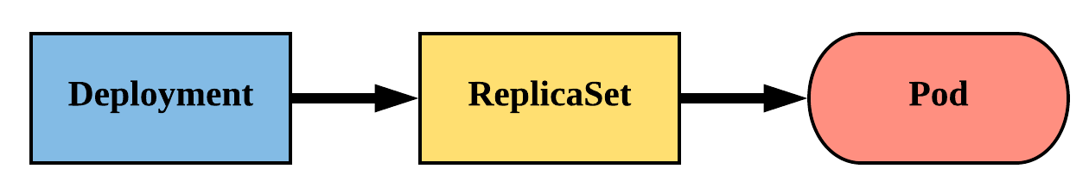
Deployment
Declarative method of managing Pods via ReplicaSets.
Provide rollback functionality and update control.
Updates are managed through the pod-template-hash label.
Each iteration creates a unique label that is assigned to both the ReplicaSet and subsequent Pods.

Slide 96
Deployment
revisionHistoryLimit: The number of previous iterations of the Deployment to retain.
strategy: Describes the method of updating the Pods based on the type. Valid options are RollingUpdate or Recreate.
RollingUpdate: Cycles through updating the Pods according to the parameters: maxSurge and maxUnavailable.
Recreate: All existing Pods are killed before the new ones are created.
apiVersion: apps/v1
kind: Deployment
metadata:
name: deploy-example
spec:
replicas: 3 revisionHistoryLimit: 3
selector:
matchLabels:
app: nginx env: prod
strategy:
type: RollingUpdate
rollingUpdate:
maxSurge: 1
maxUnavailable: 0
template:
<pod template>
Notes:
What is the default behavior?

Slide 97
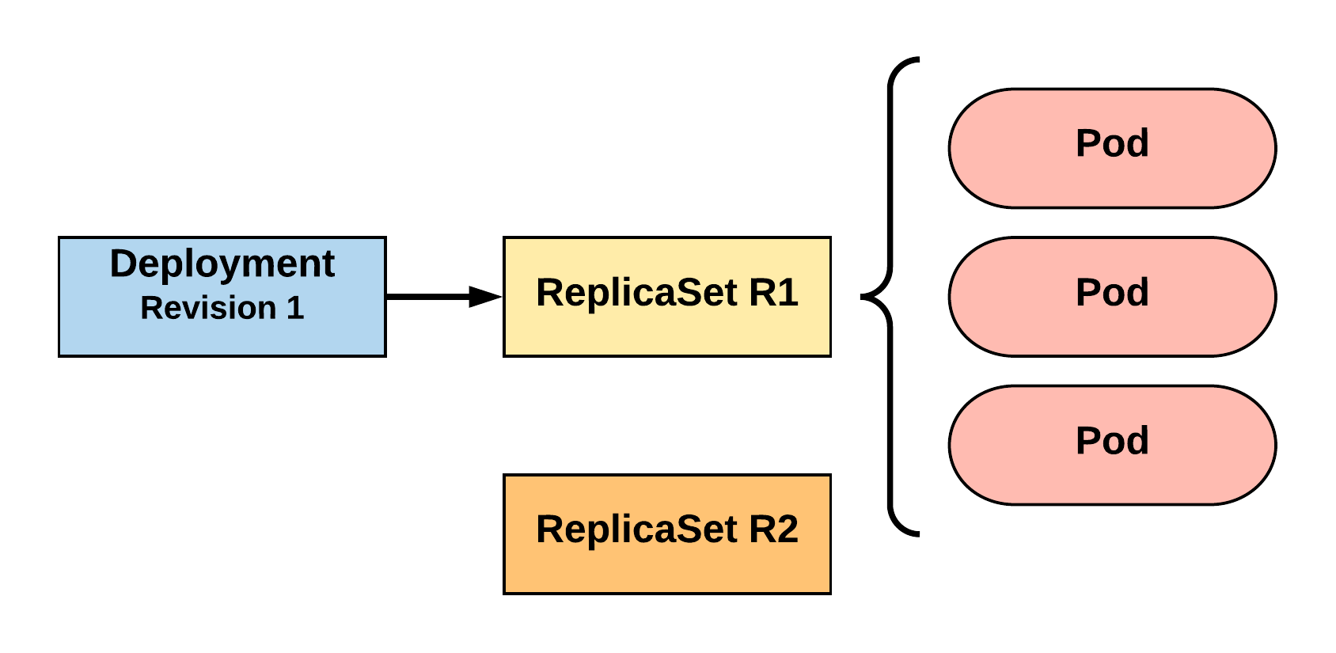
RollingUpdate Deployment
Updating pod template generates a new ReplicaSet revision.
R1 pod-template-hash: 676677fff
R2 pod-template-hash: 54f7ff7d6d
$ kubectl get replicaset
NAME DESIRED CURRENT READY AGE
mydep-6766777fff 3 3 3 5h
$ kubectl get pods
NAME READY STATUS RESTARTS AGE
mydep-6766777fff-9r2zn 1/1 Running 0 5h
mydep-6766777fff-hsfz9 1/1 Running 0 5h
mydep-6766777fff-sjxhf 1/1 Running 0 5h

Slide 98
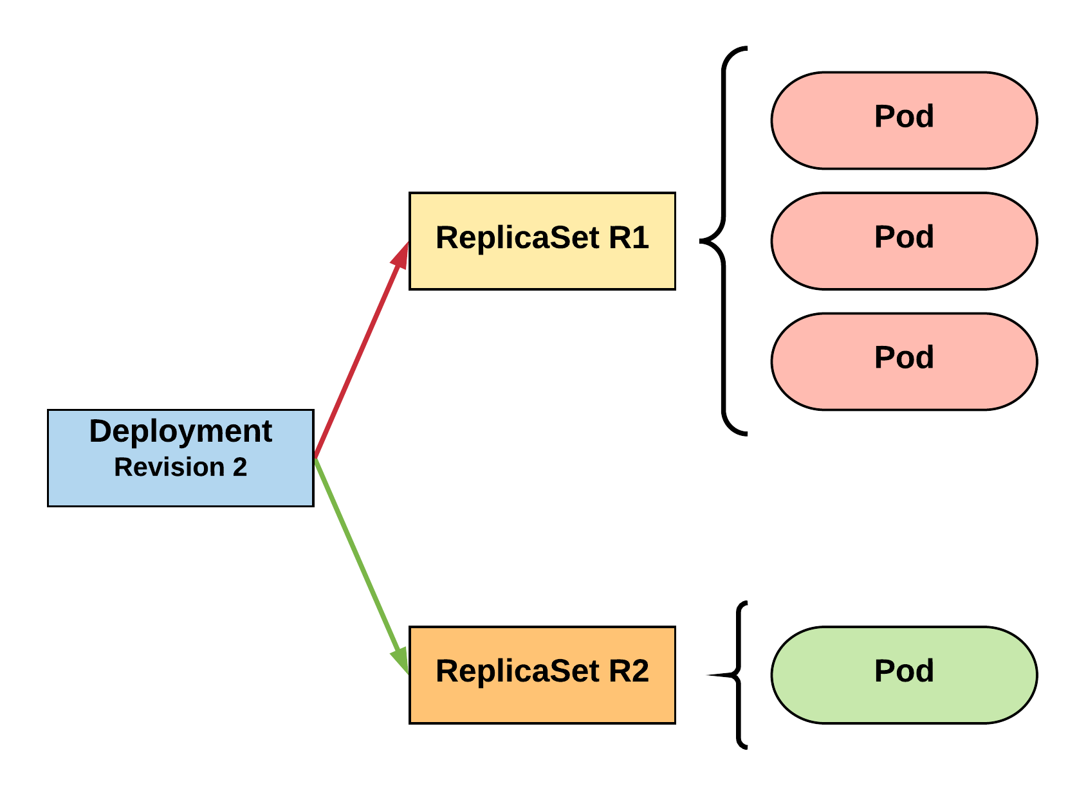
RollingUpdate Deployment
New ReplicaSet is initially scaled up based on maxSurge.
R1 pod-template-hash: 676677fff
R2 pod-template-hash: 54f7ff7d6d
$ kubectl get replicaset
NAME DESIRED CURRENT READY AGE mydep-54f7ff7d6d 1 1 1 5s
mydep-6766777fff 2 3 3 5h
$ kubectl get pods
NAME READY STATUS RESTARTS AGE
mydep-54f7ff7d6d-9gvll 1/1 Running 0 2s
mydep-6766777fff-9r2zn 1/1 Running 0 5h
mydep-6766777fff-hsfz9 1/1 Running 0 5h
mydep-6766777fff-sjxhf 1/1 Running 0 5h

Slide 99
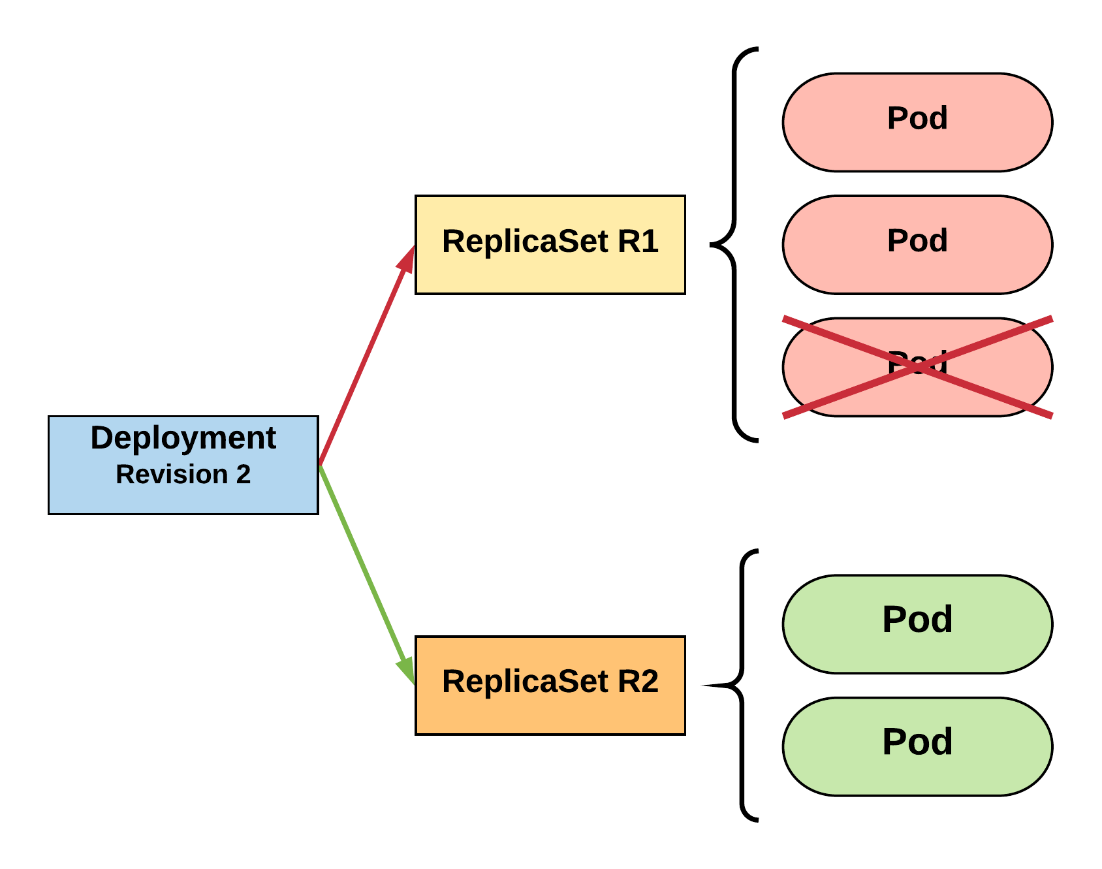
RollingUpdate Deployment
Phase out of old Pods managed by maxSurge and maxUnavailable.
R1 pod-template-hash: 676677fff
R2 pod-template-hash: 54f7ff7d6d
$ kubectl get replicaset
NAME DESIRED CURRENT READY AGE mydep-54f7ff7d6d 2 2 2 8s
mydep-6766777fff 2 2 2 5h
$ kubectl get pods
NAME READY STATUS RESTARTS AGE
mydep-54f7ff7d6d-9gvll 1/1 Running 0 5s
mydep-54f7ff7d6d-cqvlq 1/1 Running 0 2s
mydep-6766777fff-9r2zn 1/1 Running 0 5h
mydep-6766777fff-hsfz9 1/1 Running 0 5h

Slide 100
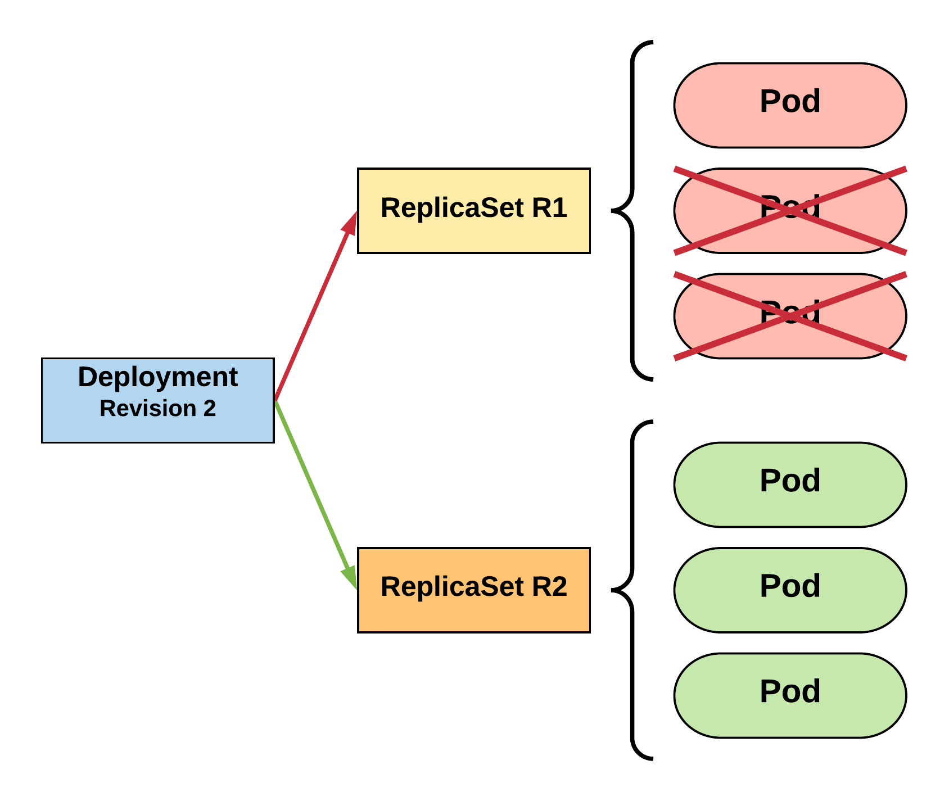
RollingUpdate Deployment
Phase out of old Pods managed by maxSurge and maxUnavailable.
R1 pod-template-hash: 676677fff
R2 pod-template-hash: 54f7ff7d6d
$ kubectl get replicaset
NAME DESIRED CURRENT READY AGE mydep-54f7ff7d6d 3 3 3 10s
mydep-6766777fff 0 1 1 5h
$ kubectl get pods
NAME READY STATUS RESTARTS AGE
mydep-54f7ff7d6d-9gvll 1/1 Running 0 7s
mydep-54f7ff7d6d-cqvlq 1/1 Running 0 5s
mydep-54f7ff7d6d-gccr6 1/1 Running 0 2s
mydep-6766777fff-9r2zn 1/1 Running 0 5h

Slide 101
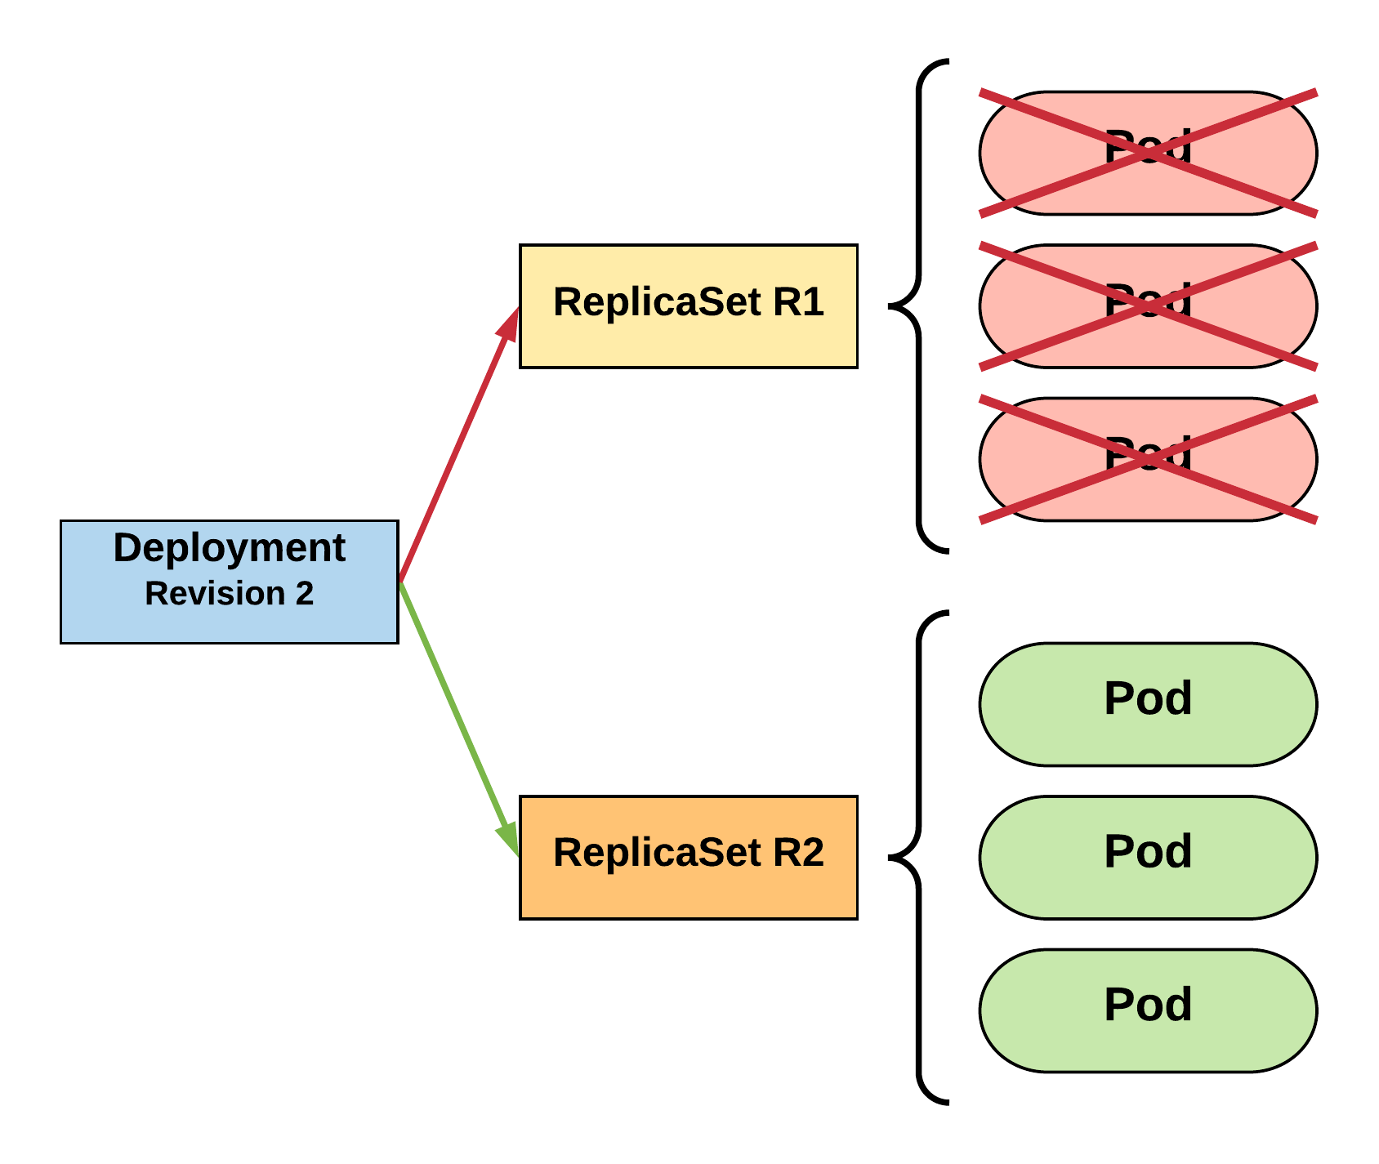
RollingUpdate Deployment
Phase out of old Pods managed by maxSurge and maxUnavailable.
R1 pod-template-hash: 676677fff
R2 pod-template-hash: 54f7ff7d6d
$ kubectl get replicaset
NAME DESIRED CURRENT READY AGE
mydep-54f7ff7d6d 3 3 3 13s mydep-6766777fff 0 0 0 5h
$ kubectl get pods
NAME READY STATUS RESTARTS AGE
mydep-54f7ff7d6d-9gvll 1/1 Running 0 10s
mydep-54f7ff7d6d-cqvlq 1/1 Running 0 8s
mydep-54f7ff7d6d-gccr6 1/1 Running 0 5s

Slide 102
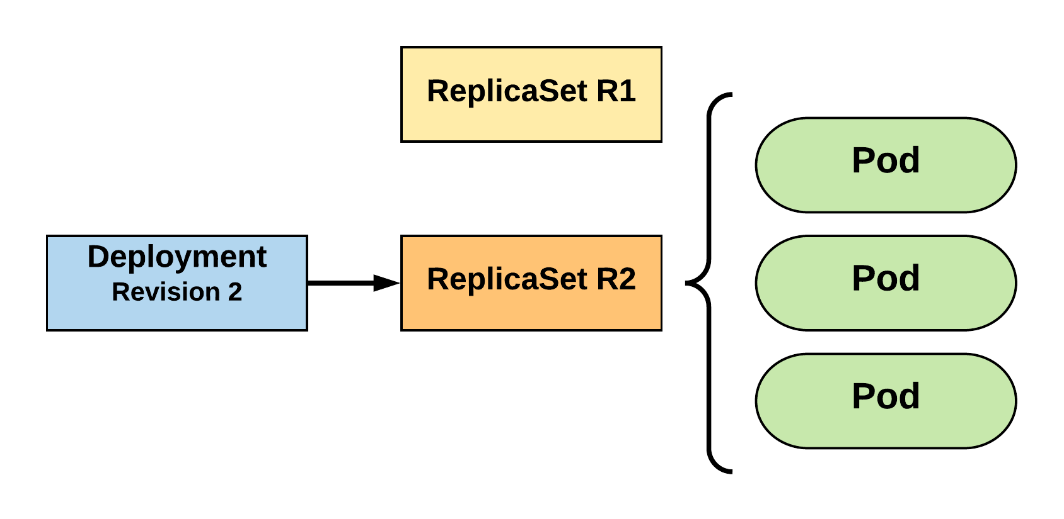
RollingUpdate Deployment
Updated to new deployment revision completed.
R1 pod-template-hash: 676677fff
R2 pod-template-hash: 54f7ff7d6d
$ kubectl get replicaset
NAME DESIRED CURRENT READY AGE mydep-54f7ff7d6d 3 3 3 15s
mydep-6766777fff 0 0 0 5h
$ kubectl get pods
NAME READY STATUS RESTARTS AGE
mydep-54f7ff7d6d-9gvll 1/1 Running 0 12s
mydep-54f7ff7d6d-cqvlq 1/1 Running 0 10s
mydep-54f7ff7d6d-gccr6 1/1 Running 0 7s

Slide 103
Deployment Demo
apiVersion: apps/v1
kind: Deployment
metadata:
name: deploy-example
spec:
replicas: 3 revisionHistoryLimit: 3
selector:
matchLabels:
app: nginx
strategy:
type: RollingUpdate
rollingUpdate:
maxSurge: 1
maxUnavailable: 0
template:
metadata:
labels:
app: nginx
spec:
containers:
- name: nginx
image: nginx:stable-alpine
ports:
- containerPort: 80
Deployment Rev 1

Slide 104
Deployment Demo
$
kubectl create -f deploy-example.yaml --record
deployment.apps "deploy-example" created
$
kubectl get rs --show-labels
NAME DESIRED CURRENT READY AGE LABELS
deploy-example-5dcc487bc7 3 3 3 21s app=nginx,pod-template-hash=1877043673
$
kubectl get pods --show-labels
NAME READY STATUS RESTARTS AGE LABELS
deploy-example-5dcc487bc7-2xrhr 1/1 Running 0 27s app=nginx,pod-template-hash=1877043673
deploy-example-5dcc487bc7-98pcw 1/1 Running 0 27s app=nginx,pod-template-hash=1877043673
deploy-example-5dcc487bc7-mxvj9 1/1 Running 0 27s app=nginx,pod-template-hash=1877043673
$
kubectl get deployments
NAME DESIRED CURRENT UP-TO-DATE AVAILABLE AGE
deploy-example 3 3 3 3 47s
$
clear

Slide 105
Deployment Demo
$
kubectl describe rs deploy-example-5dcc487bc7
Name: deploy-example-5dcc487bc7
Namespace: default
Selector: app=nginx,pod-template-hash=1877043673
apiVersion: apps/v1
Labels: app=nginx
pod-template-hash=1877043673
Annotations: deployment.kubernetes.io/desired-replicas=3
deployment.kubernetes.io/max-replicas=4
deployment.kubernetes.io/revision=1
kubernetes.io/change-cause=kubectl create --filename=deploy-example.yaml --record=true
Controlled By: Deployment/deploy-example
Replicas: 3 current / 3 desired
Pods Status: 3 Running / 0 Waiting / 0 Succeeded / 0 Failed
Pod Template:
Labels: app=nginx
pod-template-hash=1877043673
Containers:
nginx:
Image: nginx:stable-alpine
Port: 80/TCP
Host Port: 0/TCP
Environment: <none>
Mounts: <none>
Volumes: <none>
Events:
Type Reason Age From Message
---- ------ ---- ---- -------
Normal SuccessfulCreate 6m replicaset-controller Created pod: deploy-example-5dcc487bc7-mxvj9
Normal SuccessfulCreate 6m replicaset-controller Created pod: deploy-example-5dcc487bc7-2xrhr
Normal SuccessfulCreate 6m replicaset-controller Created pod: deploy-example-5dcc487bc7-98pcw
$
clear

Slide 106
Deployment Demo
apiVersion: apps/v1
kind: Deployment
metadata:
name: deploy-example
spec:
replicas: 3 revisionHistoryLimit: 3
selector:
matchLabels:
app: nginx
strategy:
type: RollingUpdate
rollingUpdate:
maxSurge: 1
maxUnavailable: 0
template:
metadata:
labels:
app: nginx
test: test
test2: test2
spec:
containers:
- name: nginx
image: nginx:stable-alpine
ports:
- containerPort: 80
Deployment Rev 2

Slide 107
Deployment Demo
$
kubectl apply -f deploy-example.yaml --record
deployment.apps "deploy-example" created
$
kubectl get rs --show-labels
NAME DESIRED CURRENT READY AGE LABELS
deploy-example-59f4596d9c 3 3 3 10s app=nginx,pod-template-hash=1590152857,test2=test2,test=test
deploy-example-5dcc487bc7 0 0 0 7m app=nginx,pod-template-hash=1877043673
$
kubectl get pods --show-labels
NAME READY STATUS RESTARTS AGE LABELS
deploy-example-59f4596d9c-274q6 1/1 Running 0 21s app=nginx,pod-template-hash=1590152857,test2=test2,test=test
deploy-example-59f4596d9c-2z8m9 1/1 Running 0 20s app=nginx,pod-template-hash=1590152857,test2=test2,test=test
deploy-example-59f4596d9c-fvbzx 1/1 Running 0 23s app=nginx,pod-template-hash=1590152857,test2=test2,test=test
$
kubectl rollout history deployment deploy-example
deployments "deploy-example"
REVISION CHANGE-CAUSE
1 kubectl create --filename=deploy-example.yaml --record=true
2 kubectl apply --filename=deploy-example.yaml --record=true
$
clear

Slide 108
Deployment Demo
$
kubectl rollout history deployment deploy-example --revision=1
deployments "deploy-example" with revision #1
Pod Template:
Labels: app=nginx
pod-template-hash=1877043673
Annotations: kubernetes.io/change-cause=kubectl create --filename=deploy-example.yaml --record=true
Containers:
nginx:
Image: nginx:stable-alpine
Port: 80/TCP
Host Port: 0/TCP
Environment: <none>
Mounts: <none>
Volumes: <none> Normal SuccessfulCreate 6m replicaset-controller Created pod: deploy-example-5dcc487bc7-98pcw
$
kubectl rollout history deployment deploy-example --revision=2
deployments "deploy-example" with revision #2
Pod Template:
Labels: app=nginx
pod-template-hash=1590152857
test=test
test2=test2
Annotations: kubernetes.io/change-cause=kubectl apply --filename=deploy-example.yaml --record=true
Containers:
nginx:
Image: nginx:stable-alpine
Port: 80/TCP
Host Port: 0/TCP
Environment: <none>
Mounts: <none>
Volumes: <none>
$

Slide 109
Deployment Demo
$
kubectl rollout undo deployment deploy-example --to-revision=1
deployment.apps "deploy-example
$
kubectl get rs --show-labels
NAME DESIRED CURRENT READY AGE LABELS
deploy-example-59f4596d9c 0 0 0 1m app=nginx,pod-template-hash=1590152857,test2=test2,test=test
deploy-example-5dcc487bc7 3 3 3 8m app=nginx,pod-template-hash=1877043673
$
kubectl get pods --show-labels
NAME READY STATUS RESTARTS AGE LABELS
deploy-example-5dcc487bc7-dx2ph 1/1 Running 0 16s app=nginx,pod-template-hash=1877043673
deploy-example-5dcc487bc7-lc79h 1/1 Running 0 17s app=nginx,pod-template-hash=1877043673
deploy-example-5dcc487bc7-vt8wf 1/1 Running 0 14s app=nginx,pod-template-hash=1877043673
$
kubectl rollout history deployment deploy-example
deployments "deploy-example"
REVISION CHANGE-CAUSE
1 kubectl create --filename=deploy-example.yaml --record=true
2 kubectl apply --filename=deploy-example.yaml --record=true
3 kubectl create --filename=deploy-example.yaml --record=true
$

Slide 110
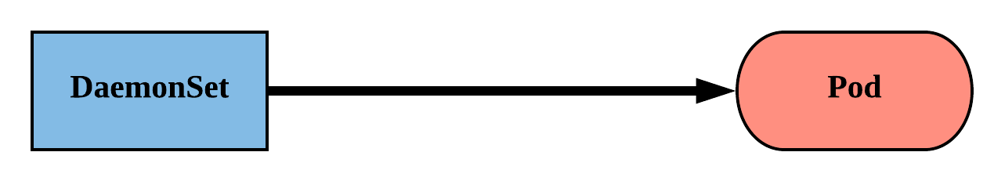
DaemonSet
Ensure that all nodes matching certain criteria will run an instance of the supplied Pod.
They bypass default scheduling mechanisms.
Are ideal for cluster wide services such as log forwarding, or health monitoring.
Revisions are managed via a controller-revision-hash label.

Slide 111
DaemonSet
revisionHistoryLimit: The number of previous iterations of the DaemonSet to retain.
updateStrategy: Describes the method of updating the Pods based on the type. Valid options are RollingUpdate or OnDelete.
RollingUpdate: Cycles through updating the Pods according to the value of maxUnavailable.
OnDelete: The new instance of the Pod is deployed ONLY after the current instance is deleted.
apiVersion: apps/v1
kind: DaemonSet
metadata:
name: ds-example
spec:
revisionHistoryLimit: 3
selector:
matchLabels:
app: nginx
updateStrategy:
type: RollingUpdate
rollingUpdate:
maxUnavailable: 1
template:
spec:
nodeSelector:
nodeType: edge
<pod template>

Slide 112
DaemonSet
spec.template.spec.nodeSelector: The primary selector used to target nodes.
Default Host Labels:
kubernetes.io/hostname
beta.kubernetes.io/os
beta.kubernetes.io/arch
Cloud Host Labels:
failure-domain.beta.kubernetes.io/zone
failure-domain.beta.kubernetes.io/region
beta.kubernetes.io/instance-type
apiVersion: apps/v1
kind: DaemonSet
metadata:
name: ds-example
spec:
revisionHistoryLimit: 3
selector:
matchLabels:
app: nginx
updateStrategy:
type: RollingUpdate
rollingUpdate:
maxUnavailable: 1
template:
spec:
nodeSelector:
nodeType: edge
<pod template>

Slide 113
DaemonSet
apiVersion: apps/v1
kind: DaemonSet
metadata:
name: ds-example
spec:
revisionHistoryLimit: 3
selector:
matchLabels:
app: nginx
updateStrategy:
type: RollingUpdate
rollingUpdate:
maxUnavailable: 1
template:
metadata:
labels:
app: nginx
spec:
nodeSelector:
nodeType: edge
containers:
- name: nginx
image: nginx:stable-alpine
ports:
- containerPort: 80
$
kubectl get pods
NAME READY STATUS RESTARTS AGE
ds-example-4wmnf 1/1 Running 0 9m
ds-example-5l7rw 1/1 Running 0 9m
ds-example-8fbhb 1/1 Running 0 9m
ds-example-dxv6t 1/1 Running 0 9m
ds-example-tmpjp 1/1 Running 0 9m
$
kubectl describe ds ds-example
Name: ds-example
Selector: app=nginx
Node-Selector: <none>
Labels: app=nginx
Annotations: deprecated.daemonset.template.generation=0
kubectl.kubernetes.io/last-applied-configuration={"apiVersion":"ap...
Desired Number of Nodes Scheduled: 5
Current Number of Nodes Scheduled: 5
Number of Nodes Scheduled with Up-to-date Pods: 5
Number of Nodes Scheduled with Available Pods: 5
Number of Nodes Misscheduled: 0
Pods Status: 5 Running / 0 Waiting / 0 Succeeded / 0 Failed
Pod Template:
Labels: app=nginx
Containers:
nginx:
Image: nginx:stable-alpine
Port: 80/TCP
Host Port: 0/TCP
Environment: <none>
Mounts: <none>
Volumes: <none>
Events:
Type Reason Age From Message
---- ------ ---- ---- -------
Normal SuccessfulCreate 11m daemonset-controller Created pod: ds-example-4wmnf
Normal SuccessfulCreate 11m daemonset-controller Created pod: ds-example-dxv6t
Normal SuccessfulCreate 11m daemonset-controller Created pod: ds-example-5l7rw
Normal SuccessfulCreate 11m daemonset-controller Created pod: ds-example-8fbhb
Normal SuccessfulCreate 11m daemonset-controller Created pod: ds-example-tmpjp

Slide 114
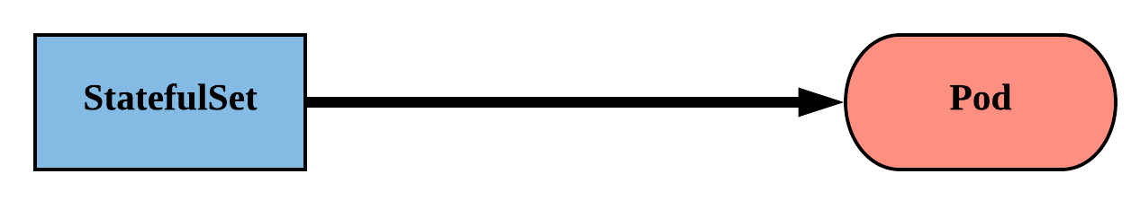
StatefulSet
Tailored to managing Pods that must persist or maintain state.
Pod identity including hostname, network, and storage WILL be persisted.
Pod lifecycle will be ordered and follow consistent patterns.

Slide 115
StatefulSet
Assigned a unique ordinal name following the convention of ‘<statefulset name>-<ordinal index>’.
Ordinal pattern is also passed to the Pod’s network Identity and volumes.
Revisions are managed via a controller-revision-hash label

Slide 116
StatefulSet
apiVersion: apps/v1
kind: StatefulSet
metadata:
name: sts-example
spec:
replicas: 2
revisionHistoryLimit: 3
selector:
matchLabels:
app: stateful
serviceName: app
updateStrategy:
type: RollingUpdate
rollingUpdate:
partition: 0
template:
metadata:
labels:
app: stateful
<continued>
<continued>
spec:
containers:
- name: nginx
image: nginx:stable-alpine
ports:
- containerPort: 80
volumeMounts:
- name: www
mountPath: /usr/share/nginx/html
volumeClaimTemplates:
- metadata:
name: www
spec:
accessModes: [ "ReadWriteOnce" ]
storageClassName: standard
resources:
requests:
storage: 1Gi

Slide 117
StatefulSet
revisionHistoryLimit: The number of previous iterations of the StatefulSet to retain.
serviceName: The name of the associated headless service; or a service without a ClusterIP.
apiVersion: apps/v1
kind: StatefulSet
metadata:
name: sts-example
spec:
replicas: 2
revisionHistoryLimit: 3
selector:
matchLabels:
app: stateful
serviceName: app
updateStrategy:
type: RollingUpdate
rollingUpdate:
partition: 0
template:
<pod template>

Slide 118
StatefulSet
updateStrategy: Describes the method of updating the Pods based on the type. Valid options are OnDelete or RollingUpdate.
OnDelete: The new instance of the Pod is deployed ONLY after the current instance is deleted.
RollingUpdate: Pods with an ordinal greater or equal than the partition value will be updated in one-by-one in reverse order.
apiVersion: apps/v1
kind: StatefulSet
metadata:
name: sts-example
spec:
replicas: 2
revisionHistoryLimit: 3
selector:
matchLabels:
app: stateful
serviceName: app
updateStrategy:
type: RollingUpdate
rollingUpdate:
partition: 0
template:
<pod template>
Notes:
The partition directive in a rolling update allows for staged or canary updates of stateful applications

Slide 119
StatefulSet
volumeClaimTemplates: Template of the persistent volume(s) request to use for each instance of the StatefulSet.
spec:
containers:
- name: nginx
image: nginx:stable-alpine
ports:
- containerPort: 80
volumeMounts:
- name: www
mountPath: /usr/share/nginx/html
volumeClaimTemplates:
- metadata:
name: www
spec:
accessModes: [ "ReadWriteOnce" ]
storageClassName: standard
resources:
requests:
storage: 1Gi

Slide 120
StatefulSet Demo
$
kubectl apply -f sts-example.yaml
statefulset.apps "sts-example" created
$
kubectl get sts sts-example --show-labels
NAME DESIRED CURRENT AGE LABELS
sts-example 2 2 1m app=stateful
$
kubectl get pods --show-labels
NAME READY STATUS RESTARTS AGE LABELS
sts-example-0 1/1 Running 0 4m app=stateful,controller-revision-hash=sts-example-588b45d64c,statefulset.kubernetes.io/pod-name=sts-example-0
sts-example-1 1/1 Running 0 4m app=stateful,controller-revision-hash=sts-example-588b45d64c,statefulset.kubernetes.io/pod-name=sts-example-1
$
kubectl get pvc
NAME STATUS VOLUME CAPACITY ACCESS MODES STORAGECLASS AGE
www-sts-example-0 Bound pvc-d2f11e3b-18d0-11e8-ba4f-080027a3682b 1Gi RWO standard 5m
www-sts-example-1 Bound pvc-d3c923c0-18d0-11e8-ba4f-080027a3682b 1Gi RWO standard 5m
$

Slide 121
Headless Service
<StatefulSet Name>-<ordinal>.<service name>.<namespace>.svc.cluster.local
apiVersion: v1
kind: Service
metadata:
name: app
spec:
clusterIP: None
selector:
app: stateful
ports:
- protocol: TCP
port: 80
targetPort: 80
/ # dig app.default.svc.cluster.local +noall +answer
; <<>> DiG 9.11.2-P1 <<>> app.default.svc.cluster.local +noall +answer
;; global options: +cmd
app.default.svc.cluster.local. 2 IN A 10.255.0.5
app.default.svc.cluster.local. 2 IN A 10.255.0.2
/ # dig sts-example-0.app.default.svc.cluster.local +noall +answer
; <<>> DiG 9.11.2-P1 <<>> sts-example-0.app.default.svc.cluster.local +noall +answer
;; global options: +cmd
sts-example-0.app.default.svc.cluster.local. 20 IN A 10.255.0.2
/ # dig sts-example-1.app.default.svc.cluster.local +noall +answer
; <<>> DiG 9.11.2-P1 <<>> sts-example-1.app.default.svc.cluster.local +noall +answer
;; global options: +cmd
sts-example-1.app.default.svc.cluster.local. 30 IN A 10.255.0.5
$ kubectl get pods
NAME READY STATUS RESTARTS AGE
sts-example-0 1/1 Running 0 11m
sts-example-1 1/1 Running 0 11m

Slide 122
Headless Service
<StatefulSet Name>-<ordinal>.<service name>.<namespace>.svc.cluster.local
apiVersion: v1
kind: Service
metadata:
name: app
spec:
clusterIP: None
selector:
app: stateful
ports:
- protocol: TCP
port: 80
targetPort: 80
/ # dig app.default.svc.cluster.local +noall +answer
; <<>> DiG 9.11.2-P1 <<>> app.default.svc.cluster.local +noall +answer
;; global options: +cmd
app.default.svc.cluster.local. 2 IN A 10.255.0.5
app.default.svc.cluster.local. 2 IN A 10.255.0.2
/ # dig sts-example-0.app.default.svc.cluster.local +noall +answer
; <<>> DiG 9.11.2-P1 <<>> sts-example-0.app.default.svc.cluster.local +noall +answer
;; global options: +cmd
sts-example-0.app.default.svc.cluster.local. 20 IN A 10.255.0.2
/ # dig sts-example-1.app.default.svc.cluster.local +noall +answer
; <<>> DiG 9.11.2-P1 <<>> sts-example-1.app.default.svc.cluster.local +noall +answer
;; global options: +cmd
sts-example-1.app.default.svc.cluster.local. 30 IN A 10.255.0.5
$ kubectl get pods
NAME READY STATUS RESTARTS AGE
sts-example-0 1/1 Running 0 11m
sts-example-1 1/1 Running 0 11m

Slide 123
Headless Service
<StatefulSet Name>-<ordinal>.<service name>.<namespace>.svc.cluster.local
apiVersion: v1
kind: Service
metadata:
name: app
spec:
clusterIP: None
selector:
app: stateful
ports:
- protocol: TCP
port: 80
targetPort: 80
/ # dig app.default.svc.cluster.local +noall +answer
; <<>> DiG 9.11.2-P1 <<>> app.default.svc.cluster.local +noall +answer
;; global options: +cmd
app.default.svc.cluster.local. 2 IN A 10.255.0.5
app.default.svc.cluster.local. 2 IN A 10.255.0.2
/ # dig sts-example-0.app.default.svc.cluster.local +noall +answer
; <<>> DiG 9.11.2-P1 <<>> sts-example-0.app.default.svc.cluster.local +noall +answer
;; global options: +cmd
sts-example-0.app.default.svc.cluster.local. 20 IN A 10.255.0.2
/ # dig sts-example-1.app.default.svc.cluster.local +noall +answer
; <<>> DiG 9.11.2-P1 <<>> sts-example-1.app.default.svc.cluster.local +noall +answer
;; global options: +cmd
sts-example-1.app.default.svc.cluster.local. 30 IN A 10.255.0.5
$ kubectl get pods
NAME READY STATUS RESTARTS AGE
sts-example-0 1/1 Running 0 11m
sts-example-1 1/1 Running 0 11m

Slide 124
VolumeClaimTemplate
<Volume Name>-<StatefulSet Name>-<ordinal>
volumeClaimTemplates:
- metadata:
name: www
spec:
accessModes: [ "ReadWriteOnce" ]
storageClassName: standard
resources:
requests:
storage: 1Gi
Persistent Volumes associated with a StatefulSet will NOT be automatically garbage collected when it’s associated StatefulSet is deleted. They must manually be removed.
$ kubectl get pvc
NAME STATUS VOLUME CAPACITY ACCESS MODES STORAGECLASS AGE
www-sts-example-0 Bound pvc-d2f11e3b-18d0-11e8-ba4f-080027a3682b 1Gi RWO standard 4h
www-sts-example-1 Bound pvc-d3c923c0-18d0-11e8-ba4f-080027a3682b 1Gi RWO standard 4h

Slide 125
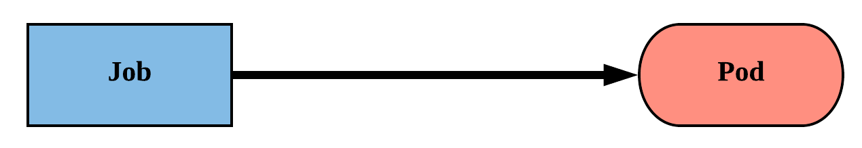
Job
Job controller ensures one or more pods are executed and successfully terminate.
Will continue to try and execute the job until it satisfies the completion and/or parallelism condition.
Pods are NOT cleaned up until the job itself is deleted.

Slide 126
Job
backoffLimit: The number of failures before the job itself is considered failed.
completions: The total number of successful completions desired.
parallelism: How many instances of the pod can be run concurrently.
spec.template.spec.restartPolicy:Jobs only support a restartPolicy of type Never or OnFailure.
apiVersion: batch/v1
kind: Job
metadata:
name: job-example
spec:
backoffLimit: 4
completions: 4
parallelism: 2
template:
spec:
restartPolicy: Never
<pod-template>

Slide 127
Job
apiVersion: batch/v1
kind: Job
metadata:
name: job-example
spec:
backoffLimit: 4
completions: 4
parallelism: 2
template:
spec:
containers:
- name: hello
image: alpine:latest
command: ["/bin/sh", "-c"]
args: ["echo hello from $HOSTNAME!"]
restartPolicy: Never
$ kubectl describe job job-example
Name: job-example
Namespace: default
Selector: controller-uid=19d122f4-1576-11e8-a4e2-080027a3682b
Labels: controller-uid=19d122f4-1576-11e8-a4e2-080027a3682b
job-name=job-example
Annotations: <none>
Parallelism: 2
Completions: 4
Start Time: Mon, 19 Feb 2018 08:09:21 -0500
Pods Statuses: 0 Running / 4 Succeeded / 0 Failed
Pod Template:
Labels: controller-uid=19d122f4-1576-11e8-a4e2-080027a3682b
job-name=job-example
Containers:
hello:
Image: alpine:latest
Port: <none>
Command:
/bin/sh
-c
Args:
echo hello from $HOSTNAME!
Environment: <none>
Mounts: <none>
Volumes: <none>
Events:
Type Reason Age From Message
---- ------ ---- ---- -------
Normal SuccessfulCreate 52m job-controller Created pod: job-example-v5fvq
Normal SuccessfulCreate 52m job-controller Created pod: job-example-hknns
Normal SuccessfulCreate 51m job-controller Created pod: job-example-tphkm
Normal SuccessfulCreate 51m job-controller Created pod: job-example-dvxd2
$ kubectl get pods --show-all
NAME READY STATUS RESTARTS AGE
job-example-dvxd2 0/1 Completed 0 51m
job-example-hknns 0/1 Completed 0 52m
job-example-tphkm 0/1 Completed 0 51m
job-example-v5fvq 0/1 Completed 0 52m
Notes:
controller-uid is added as a label to the generated pods

Slide 128
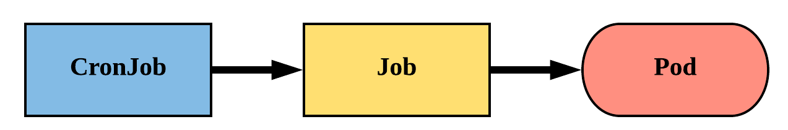
CronJob
An extension of the Job Controller, it provides a method of executing jobs on a cron-like schedule.
CronJobs within Kubernetes use UTC ONLY.

Slide 129
CronJob
schedule: The cron schedule for the job.
successfulJobHistoryLimit: The number of successful jobs to retain.
failedJobHistoryLimit: The number of failed jobs to retain.
apiVersion: batch/v1beta1
kind: CronJob
metadata:
name: cronjob-example
spec:
schedule: "*/1 * * * *"
successfulJobsHistoryLimit: 3
failedJobsHistoryLimit: 1
jobTemplate:
spec:
completions: 4
parallelism: 2
template:
<pod template>

Slide 130
CronJob
apiVersion: batch/v1beta1
kind: CronJob
metadata:
name: cronjob-example
spec:
schedule: "*/1 * * * *"
successfulJobsHistoryLimit: 3
failedJobsHistoryLimit: 1
jobTemplate:
spec:
completions: 4
parallelism: 2
template:
spec:
containers:
- name: hello
image: alpine:latest
command: ["/bin/sh", "-c"]
args: ["echo hello from $HOSTNAME!"]
restartPolicy: Never
$ kubectl describe cronjob cronjob-example
Name: cronjob-example
Namespace: default
Labels: <none>
Annotations: <none>
Schedule: */1 * * * *
Concurrency Policy: Allow
Suspend: False
Starting Deadline Seconds: <unset>
Selector: <unset>
Parallelism: 2
Completions: 4
Pod Template:
Labels: <none>
Containers:
hello:
Image: alpine:latest
Port: <none>
Command:
/bin/sh
-c
Args:
echo hello from $HOSTNAME!
Environment: <none>
Mounts: <none>
Volumes: <none>
Last Schedule Time: Mon, 19 Feb 2018 09:54:00 -0500
Active Jobs: cronjob-example-1519052040
Events:
Type Reason Age From Message
---- ------ ---- ---- -------
Normal SuccessfulCreate 3m cronjob-controller Created job cronjob-example-1519051860
Normal SawCompletedJob 2m cronjob-controller Saw completed job: cronjob-example-1519051860
Normal SuccessfulCreate 2m cronjob-controller Created job cronjob-example-1519051920
Normal SawCompletedJob 1m cronjob-controller Saw completed job: cronjob-example-1519051920
Normal SuccessfulCreate 1m cronjob-controller Created job cronjob-example-1519051980
$ kubectl get jobs
NAME DESIRED SUCCESSFUL AGE
cronjob-example-1519053240 4 4 2m
cronjob-example-1519053300 4 4 1m
cronjob-example-1519053360 4 4 26s

Slide 131
Working with Volumes

Slide 132
Volumes
Persistent Volumes
Persistent Volume Claims
StorageClass
Storage
Concepts and Resources

Slide 133
Storage
Pods by themselves are useful, but many workloads require exchanging data between containers, or persisting some form of data.
For this we have Volumes, PersistentVolumes, PersistentVolumeClaims, and StorageClasses.

Slide 134
Volumes
Storage that is tied to the Pod’s Lifecycle.
A pod can have one or more types of volumes attached to it.
Can be consumed by any of the containers within the pod.
Survive Pod restarts; however their durability beyond that is dependent on the Volume Type.

Slide 135
Volume Types
awsElasticBlockStore
azureDisk
azureFile
cephfs
configMap
csi
downwardAPI
emptyDir
fc (fibre channel)
flexVolume
flocker
gcePersistentDisk
gitRepo
glusterfs
hostPath
iscsi
local
nfs
persistentVolumeClaim
projected
portworxVolume
quobyte
rbd
scaleIO
secret
storageos
vsphereVolume
Persistent Volume Supported

Slide 136
Volumes
volumes: A list of volume objects to be attached to the Pod. Every object within the list must have it’s own unique name.
volumeMounts: A container specific list referencing the Pod volumes by name, along with their desired mountPath.
apiVersion: v1
kind: Pod
metadata:
name: volume-example
spec:
containers:
- name: nginx
image: nginx:stable-alpine
volumeMounts:
- name: html
mountPath: /usr/share/nginx/html
ReadOnly: true
- name: content
image: alpine:latest
command: ["/bin/sh", "-c"]
args:
- while true; do
date >> /html/index.html;
sleep 5;
done
volumeMounts:
- name: html
mountPath: /html
volumes:
- name: html
emptyDir: {}

Slide 137
Volumes
volumes: A list of volume objects to be attached to the Pod. Every object within the list must have it’s own unique name.
volumeMounts: A container specific list referencing the Pod volumes by name, along with their desired mountPath.
apiVersion: v1
kind: Pod
metadata:
name: volume-example
spec:
containers:
- name: nginx
image: nginx:stable-alpine
volumeMounts:
- name: html
mountPath: /usr/share/nginx/html
ReadOnly: true
- name: content
image: alpine:latest
command: ["/bin/sh", "-c"]
args:
- while true; do
date >> /html/index.html;
sleep 5;
done
volumeMounts:
- name: html
mountPath: /html
volumes:
- name: html
emptyDir: {}
Notes:
Volumes can reference different volume types
each one just requires a unique name

Slide 138
Volumes
volumes: A list of volume objects to be attached to the Pod. Every object within the list must have it’s own unique name.
volumeMounts: A container specific list referencing the Pod volumes by name, along with their desired mountPath.
apiVersion: v1
kind: Pod
metadata:
name: volume-example
spec:
containers:
- name: nginx
image: nginx:stable-alpine
volumeMounts:
- name: html
mountPath: /usr/share/nginx/html
ReadOnly: true
- name: content
image: alpine:latest
command: ["/bin/sh", "-c"]
args:
- while true; do
date >> /html/index.html;
sleep 5;
done
volumeMounts:
- name: html
mountPath: /html
volumes:
- name: html
emptyDir: {}

Slide 139
Persistent Volumes
A PersistentVolume (PV) represents a storage resource.
PVs are a cluster wide resource linked to a backing storage provider: NFS, GCEPersistentDisk, RBD etc.
Generally provisioned by an administrator.
Their lifecycle is handled independently from a pod
CANNOT be attached to a Pod directly. Relies on a PersistentVolumeClaim

Slide 140
PersistentVolumeClaims
A PersistentVolumeClaim (PVC) is a namespaced request for storage.
Satisfies a set of requirements instead of mapping to a storage resource directly.
Ensures that an application’s ‘claim’ for storage is portable across numerous backends or providers.

Slide 141
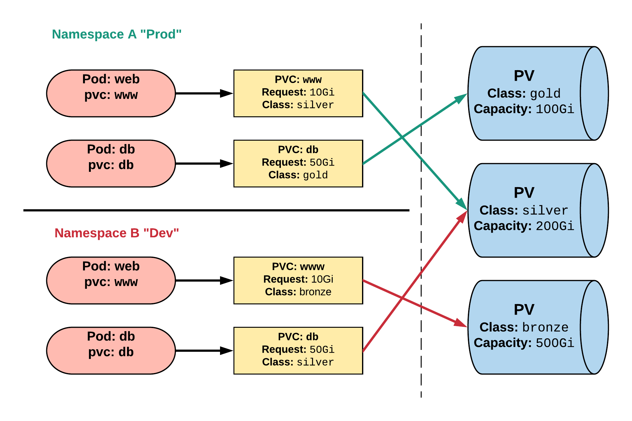
Persistent Volumes and Claims
Cluster Users
Cluster Admins
Notes:
PVCs can be named the same to make things consistent but point to different storage classes

Slide 142
PersistentVolume
capacity.storage: The total amount of available storage.
volumeMode: The type of volume, this can be either Filesystem or Block.
accessModes: A list of the supported methods of accessing the volume. Options include:
ReadWriteOnce
ReadOnlyMany
ReadWriteMany
apiVersion: v1
kind: PersistentVolume
metadata:
name: nfsserver
spec:
capacity:
storage: 50Gi
volumeMode: Filesystem
accessModes:
- ReadWriteOnce
- ReadWriteMany
persistentVolumeReclaimPolicy: Delete
storageClassName: slow mountOptions:
- hard
- nfsvers=4.1
nfs:
path: /exports
server: 172.22.0.42

Slide 143
PersistentVolume
persistentVolumeReclaimPolicy: The behaviour for PVC’s that have been deleted. Options include:
Retain - manual clean-up
Delete - storage asset deleted by provider.
storageClassName: Optional name of the storage class that PVC’s can reference. If provided, ONLY PVC’s referencing the name consume use it.
mountOptions: Optional mount options for the PV.
apiVersion: v1
kind: PersistentVolume
metadata:
name: nfsserver
spec:
capacity:
storage: 50Gi
volumeMode: Filesystem
accessModes:
- ReadWriteOnce
- ReadWriteMany
persistentVolumeReclaimPolicy: Delete
storageClassName: slow mountOptions:
- hard
- nfsvers=4.1
nfs:
path: /exports
server: 172.22.0.42
Notes:
recycle is being deprecated

Slide 144
PersistentVolumeClaim
accessModes: The selected method of accessing the storage. This MUST be a subset of what is defined on the target PV or Storage Class.
ReadWriteOnce
ReadOnlyMany
ReadWriteMany
resources.requests.storage: The desired amount of storage for the claim
storageClassName: The name of the desired Storage Class
kind: PersistentVolumeClaim
apiVersion: v1
metadata:
name: pvc-sc-example
spec:
accessModes:
- ReadWriteOnce
resources:
requests:
storage: 1Gi
storageClassName: slow

Slide 145
PVs and PVCs with Selectors
kind: PersistentVolume
apiVersion: v1
metadata:
name: pv-selector-example
labels:
type: hostpath
spec:
capacity:
storage: 2Gi
accessModes:
- ReadWriteMany
hostPath:
path: "/mnt/data"
kind: PersistentVolumeClaim
apiVersion: v1
metadata:
name: pvc-selector-example
spec:
accessModes:
- ReadWriteMany
resources:
requests:
storage: 1Gi
selector:
matchLabels:
type: hostpath

Slide 146
PVs and PVCs with Selectors
kind: PersistentVolume
apiVersion: v1
metadata:
name: pv-selector-example
labels:
type: hostpath
spec:
capacity:
storage: 2Gi
accessModes:
- ReadWriteMany
hostPath:
path: "/mnt/data"
kind: PersistentVolumeClaim
apiVersion: v1
metadata:
name: pvc-selector-example
spec:
accessModes:
- ReadWriteMany
resources:
requests:
storage: 1Gi
selector:
matchLabels:
type: hostpath

Slide 147
PV Phases
Available
PV is ready and available to be consumed.
Bound
The PV has been bound to a claim.
Released
The binding PVC has been deleted, and the PV is pending reclamation.
Failed
An error has been encountered attempting to reclaim the PV.

Slide 148
StorageClass
Storage classes are an abstraction on top of an external storage resource (PV)
Work hand-in-hand with the external storage system to enable dynamic provisioning of storage
Eliminates the need for the cluster admin to pre-provision a PV

Slide 149
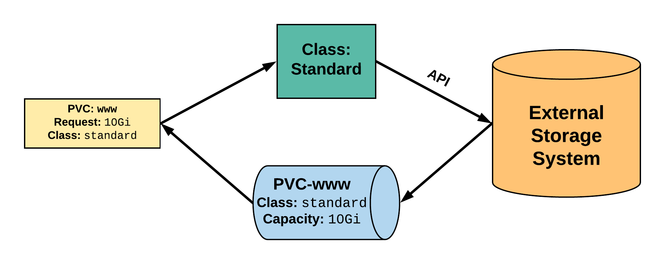
StorageClass
2. StorageClass provisions request through API with external storage system.
1. PVC makes a request of the StorageClass.
uid: 9df65c6e-1a69-11e8-ae10-080027a3682b
4. provisioned PV is bound to requesting PVC.
3. External storage system creates a PV strictly satisfying the PVC request.
pv: pvc-9df65c6e-1a69-11e8-ae10-080027a3682b
Notes:
the pv name is pvc-<pvc uid>

Slide 150
StorageClass
provisioner: Defines the ‘driver’ to be used for provisioning of the external storage.
parameters: A hash of the various configuration parameters for the provisioner.
reclaimPolicy: The behaviour for the backing storage when the PVC is deleted.
Retain - manual clean-up
Delete - storage asset deleted by provider
kind: StorageClass
apiVersion: storage.k8s.io/v1
metadata:
name: standard
provisioner: kubernetes.io/gce-pd
parameters:
type: pd-standard
zones: us-central1-a, us-central1-b
reclaimPolicy: Delete

Slide 151
Available StorageClasses
AWSElasticBlockStore
AzureFile
AzureDisk
CephFS
Cinder
FC
FlexVolume
Flocker
GCEPersistentDisk
Glusterfs
iSCSI
PhotonPersistentDisk
Quobyte
NFS
RBD
VsphereVolume
PortworxVolume
ScaleIO
StorageOS
Local
Internal Provisioner

Slide 152
ConfigMap
Secret
Configuration
Concepts and Resources

Slide 153
Configuration
Kubernetes has an integrated pattern for decoupling configuration from application or container.
This pattern makes use of two Kubernetes components: ConfigMaps and Secrets.

Slide 154
ConfigMap
Externalized data stored within kubernetes.
Can be referenced through several different means:
environment variable
a command line argument (via env var)
injected as a file into a volume mount
Can be created from a manifest, literals, directories, or files directly.

Slide 155
ConfigMap
data: Contains key-value pairs of ConfigMap contents.
apiVersion: v1
kind: ConfigMap
metadata:
name: manifest-example
data:
state: Michigan
city: Ann Arbor
content: |
Look at this,
its multiline!

Slide 156
ConfigMap Example
All produce a ConfigMap with the same content!
apiVersion: v1
kind: ConfigMap
metadata:
name: manifest-example
data:
city: Ann Arbor
state: Michigan
$ kubectl create configmap literal-example \
> --from-literal="city=Ann Arbor" --from-literal=state=Michigan
configmap “literal-example” created
$ cat info/city
Ann Arbor
$ cat info/state
Michigan
$ kubectl create configmap dir-example --from-file=cm/
configmap "dir-example" created
$ cat info/city
Ann Arbor
$ cat info/state
Michigan
$ kubectl create configmap file-example --from-file=cm/city --from-file=cm/state
configmap "file-example" created

Slide 157
ConfigMap Example
All produce a ConfigMap with the same content!
apiVersion: v1
kind: ConfigMap
metadata:
name: manifest-example
data:
city: Ann Arbor
state: Michigan
$ kubectl create configmap literal-example \
> --from-literal="city=Ann Arbor" --from-literal=state=Michigan
configmap “literal-example” created
$ cat info/city
Ann Arbor
$ cat info/state
Michigan
$ kubectl create configmap dir-example --from-file=cm/
configmap "dir-example" created
$ cat info/city
Ann Arbor
$ cat info/state
Michigan
$ kubectl create configmap file-example --from-file=cm/city --from-file=cm/state
configmap "file-example" created

Slide 158
ConfigMap Example
All produce a ConfigMap with the same content!
apiVersion: v1
kind: ConfigMap
metadata:
name: manifest-example
data:
city: Ann Arbor
state: Michigan
$ kubectl create configmap literal-example \
> --from-literal="city=Ann Arbor" --from-literal=state=Michigan
configmap “literal-example” created
$ cat info/city
Ann Arbor
$ cat info/state
Michigan
$ kubectl create configmap dir-example --from-file=cm/
configmap "dir-example" created
$ cat info/city
Ann Arbor
$ cat info/state
Michigan
$ kubectl create configmap file-example --from-file=cm/city --from-file=cm/state
configmap "file-example" created

Slide 159
ConfigMap Example
All produce a ConfigMap with the same content!
apiVersion: v1
kind: ConfigMap
metadata:
name: manifest-example
data:
city: Ann Arbor
state: Michigan
$ kubectl create configmap literal-example \
> --from-literal="city=Ann Arbor" --from-literal=state=Michigan
configmap “literal-example” created
$ cat info/city
Ann Arbor
$ cat info/state
Michigan
$ kubectl create configmap dir-example --from-file=cm/
configmap "dir-example" created
$ cat info/city
Ann Arbor
$ cat info/state
Michigan
$ kubectl create configmap file-example --from-file=cm/city --from-file=cm/state
configmap "file-example" created

Slide 160
Secret
Functionally identical to a ConfigMap.
Stored as base64 encoded content.
Encrypted at rest within etcd (if configured!).
Ideal for username/passwords, certificates or other sensitive information that should not be stored in a container.
Can be created from a manifest, literals, directories, or from files directly.

Slide 161
Secret
type: There are three different types of secrets within Kubernetes:
docker-registry - credentials used to authenticate to a container registry
generic/Opaque - literal values from different sources
tls - a certificate based secret
data: Contains key-value pairs of base64 encoded content.
apiVersion: v1
kind: Secret
metadata:
name: manifest-secret
type: Opaque
data:
username: ZXhhbXBsZQ==
password: bXlwYXNzd29yZA==

Slide 162
Secret Example
All produce a Secret with the same content!
apiVersion: v1
kind: Secret
metadata:
name: manifest-example
type: Opaque
data:
username: ZXhhbXBsZQ==
password: bXlwYXNzd29yZA==
$ kubectl create secret generic literal-secret \ > --from-literal=username=example \ > --from-literal=password=mypassword
secret "literal-secret" created
$ cat info/username
example
$ cat info/password
mypassword
$ kubectl create secret generic dir-secret --from-file=secret/
Secret "file-secret" created
$ cat secret/username
example
$ cat secret/password
mypassword
$ kubectl create secret generic file-secret --from-file=secret/username --from-file=secret/password
Secret "file-secret" created

Slide 163
Secret Example
All produce a Secret with the same content!
apiVersion: v1
kind: Secret
metadata:
name: manifest-example
type: Opaque
data:
username: ZXhhbXBsZQ==
password: bXlwYXNzd29yZA==
$ kubectl create secret generic literal-secret \ > --from-literal=username=example \ > --from-literal=password=mypassword
secret "literal-secret" created
$ cat info/username
example
$ cat info/password
mypassword
$ kubectl create secret generic dir-secret --from-file=secret/
Secret "file-secret" created
$ cat secret/username
example
$ cat secret/password
mypassword
$ kubectl create secret generic file-secret --from-file=secret/username --from-file=secret/password
Secret "file-secret" created

Slide 164
Secret Example
All produce a Secret with the same content!
apiVersion: v1
kind: Secret
metadata:
name: manifest-example
type: Opaque
data:
username: ZXhhbXBsZQ==
password: bXlwYXNzd29yZA==
$ kubectl create secret generic literal-secret \ > --from-literal=username=example \ > --from-literal=password=mypassword
secret "literal-secret" created
$ cat info/username
example
$ cat info/password
mypassword
$ kubectl create secret generic dir-secret --from-file=secret/
Secret "file-secret" created
$ cat secret/username
example
$ cat secret/password
mypassword
$ kubectl create secret generic file-secret --from-file=secret/username --from-file=secret/password
Secret "file-secret" created

Slide 165
Secret Example
All produce a Secret with the same content!
apiVersion: v1
kind: Secret
metadata:
name: manifest-example
type: Opaque
data:
username: ZXhhbXBsZQ==
password: bXlwYXNzd29yZA==
$ kubectl create secret generic literal-secret \ > --from-literal=username=example \ > --from-literal=password=mypassword
secret "literal-secret" created
$ cat info/username
example
$ cat info/password
mypassword
$ kubectl create secret generic dir-secret --from-file=secret/
Secret "file-secret" created
$ cat secret/username
example
$ cat secret/password
mypassword
$ kubectl create secret generic file-secret --from-file=secret/username --from-file=secret/password
Secret "file-secret" created

Slide 166
Injecting as Environment Variable
apiVersion: batch/v1
kind: Job
metadata:
name: cm-env-example
spec:
template:
spec:
containers:
- name: mypod
image: alpine:latest
command: [“/bin/sh”, “-c”]
args: [“printenv CITY”]
env:
- name: CITY
valueFrom:
configMapKeyRef:
name: manifest-example
key: city
restartPolicy: Never
apiVersion: batch/v1
kind: Job
metadata:
name: secret-env-example
spec:
template:
spec:
containers:
- name: mypod
image: alpine:latest
command: [“/bin/sh”, “-c”]
args: [“printenv USERNAME”]
env:
- name: USERNAME
valueFrom:
secretKeyRef:
name: manifest-example
key: username
restartPolicy: Never

Slide 167
Injecting in a Command
apiVersion: batch/v1
kind: Job
metadata:
name: cm-cmd-example
spec:
template:
spec:
containers:
- name: mypod
image: alpine:latest
command: [“/bin/sh”, “-c”]
args: [“echo Hello ${CITY}!”]
env:
- name: CITY
valueFrom:
configMapKeyRef:
name: manifest-example
key: city
restartPolicy: Never
apiVersion: batch/v1
kind: Job
metadata:
name: secret-cmd-example
spec:
template:
spec:
containers:
- name: mypod
image: alpine:latest
command: [“/bin/sh”, “-c”]
args: [“echo Hello ${USERNAME}!”]
env:
- name: USERNAME
valueFrom:
secretKeyRef:
name: manifest-example
key: username
restartPolicy: Never

Slide 168
Injecting as a Volume
apiVersion: batch/v1
kind: Job
metadata:
name: cm-vol-example
spec:
template:
spec:
containers:
- name: mypod
image: alpine:latest
command: [“/bin/sh”, “-c”]
args: [“cat /myconfig/city”]
volumeMounts:
- name: config-volume
mountPath: /myconfig
restartPolicy: Never
volumes:
- name: config-volume
configMap:
name: manifest-example
apiVersion: batch/v1
kind: Job
metadata:
name: secret-vol-example
spec:
template:
spec:
containers:
- name: mypod
image: alpine:latest
command: [“/bin/sh”, “-c”]
args: [“cat /mysecret/username”]
volumeMounts:
- name: secret-volume
mountPath: /mysecret
restartPolicy: Never
volumes:
- name: secret-volume
secret:
secretName: manifest-example

Slide 169
Where to go From Here

Slide 170
SIGs
Kubernetes components and features are broken down into smaller self-managed communities known as Special Interest Groups (SIG).
Hold weekly public recorded meetings and have their own mailing lists and slack channels.

Slide 171
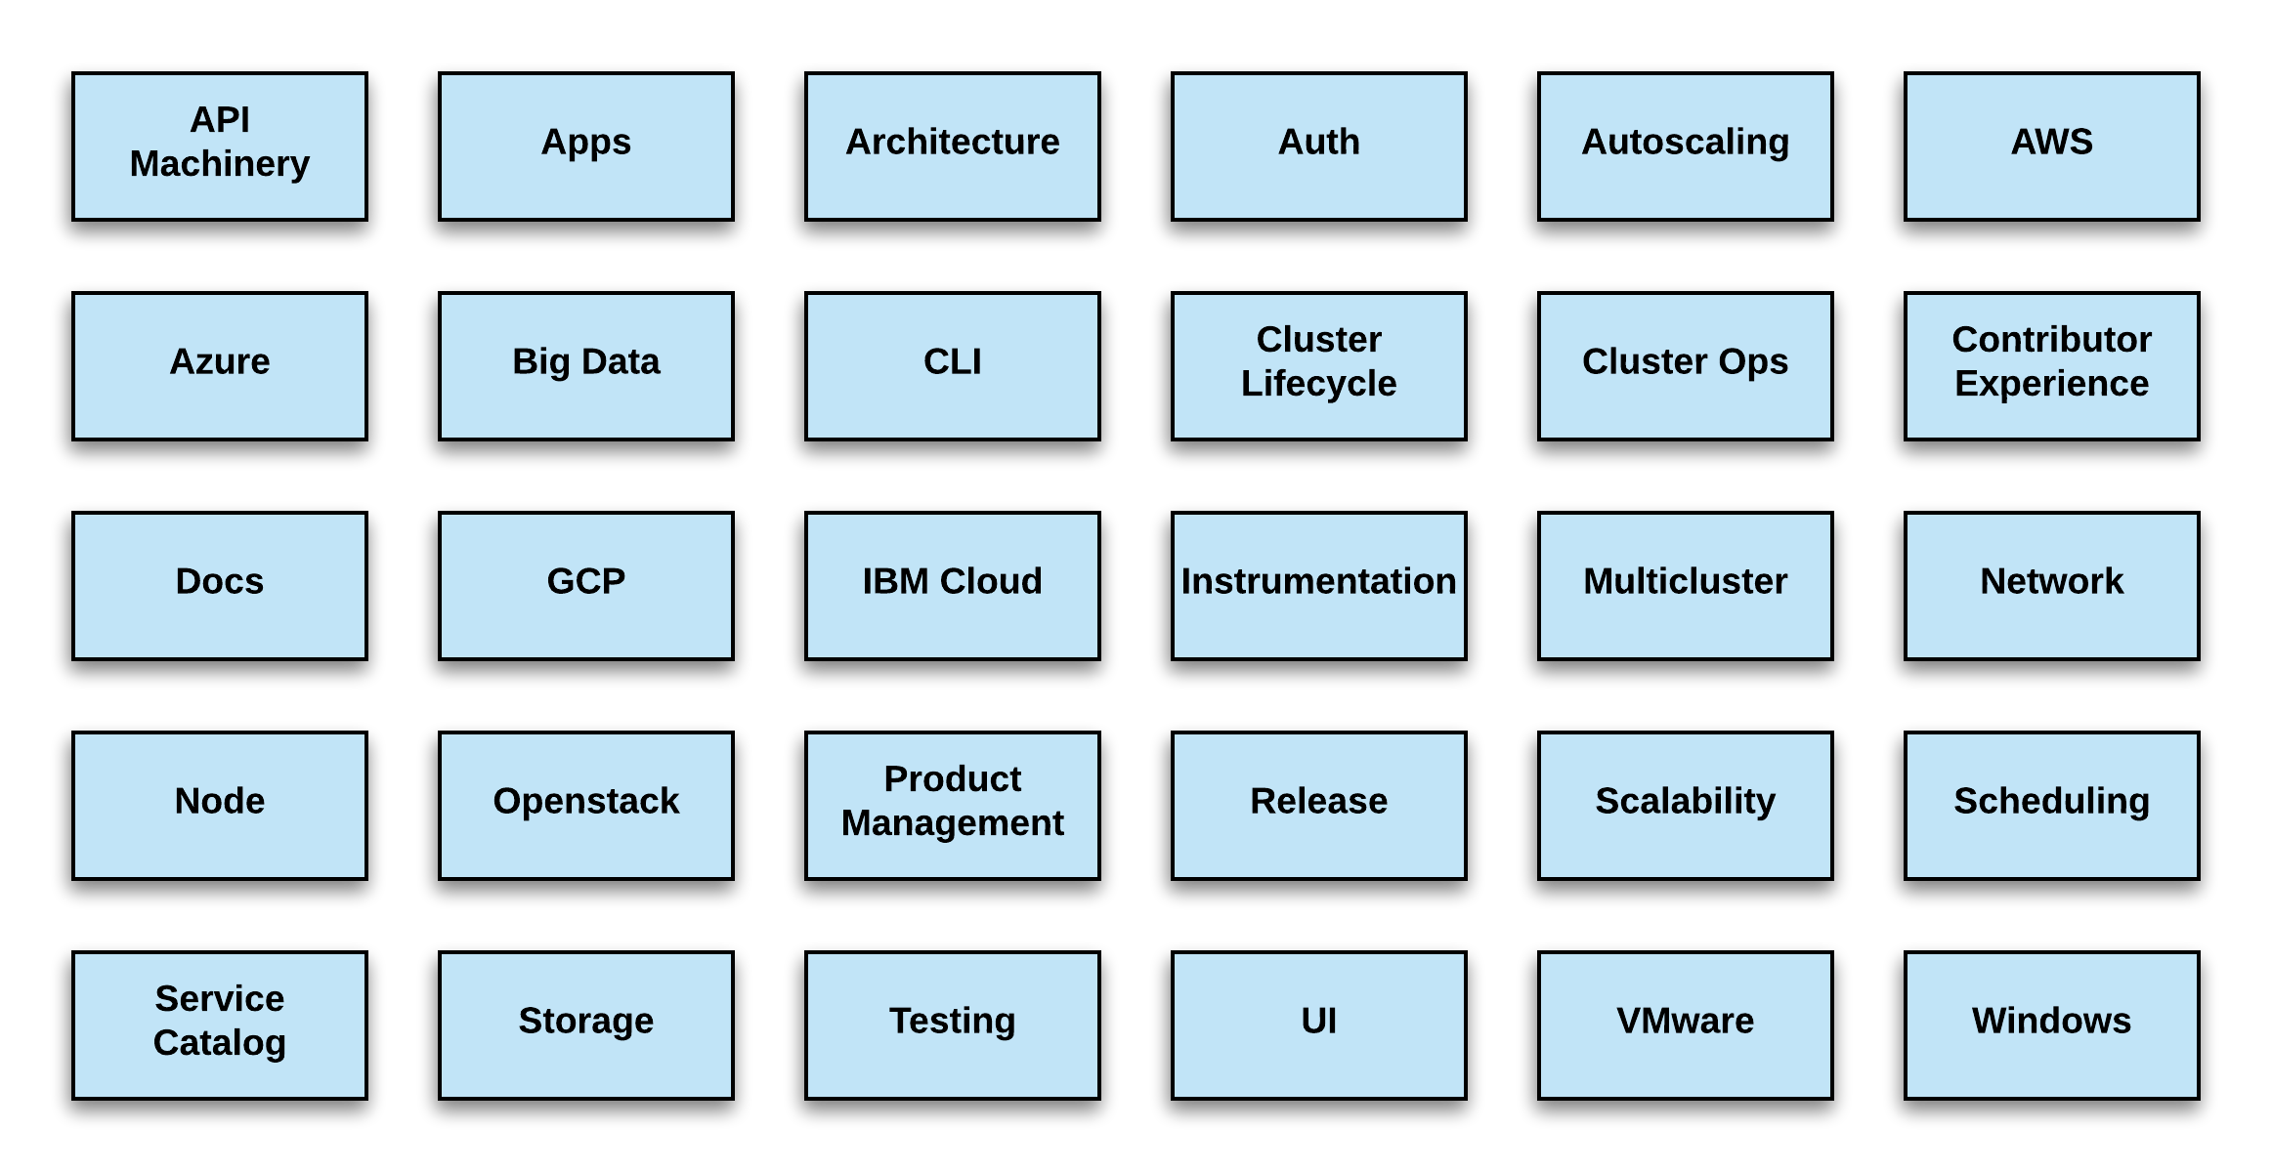
SIG List
https://github.com/kubernetes/community/blob/master/sig-list.md
5/21/2018

Slide 172
Working Groups
Similar to SIGs, but are topic focused, time-bounded, or act as a focal point for cross-sig coordination.
Hold scheduled publicly recorded meetings in addition to having their own mailing lists and slack channels.

Slide 173
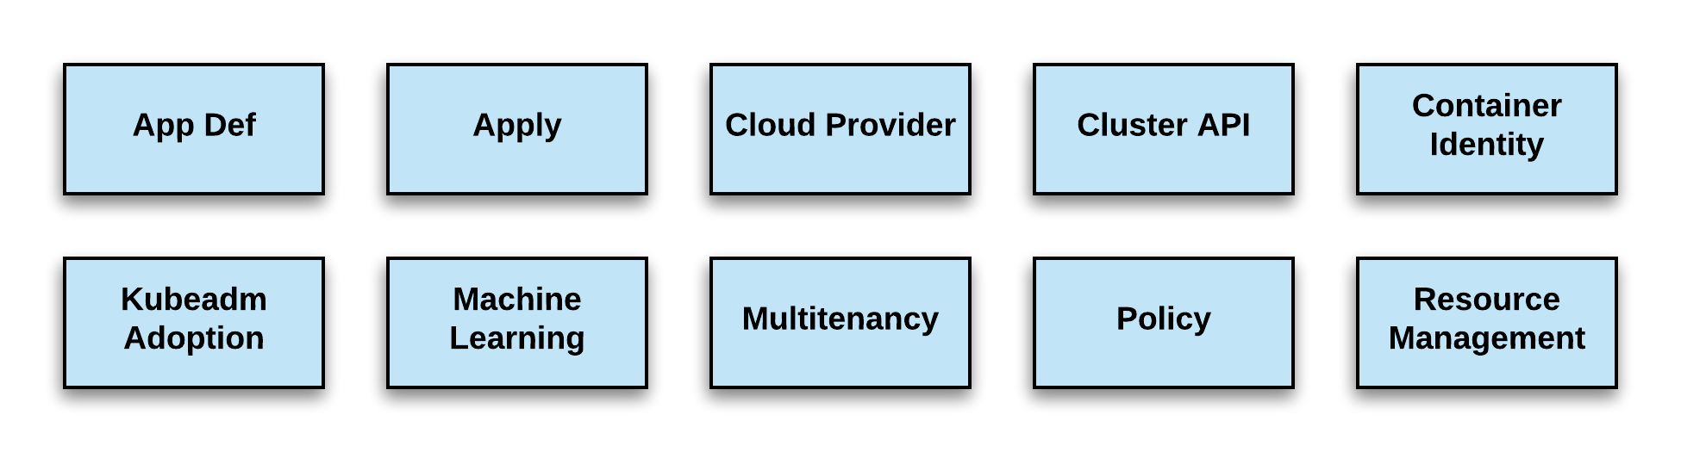
WG List
https://github.com/kubernetes/community/blob/master/sig-list.md
6/21/2018

Slide 174

Slack
Kubernetes
slack.k8s.io
40,000+ users
160+ public channels
CNCF
slack.cncf.io
3,500+ users
70+ public channels
7/12/2018

Slide 175
Meetups
Kubernetes
meetup.com/topics/kubernetes/
570+ groups
200,000+ members
CNCF
meetups.cncf.io
145+ groups
73,000+ members
30+ countries
7/12/2018

Slide 176
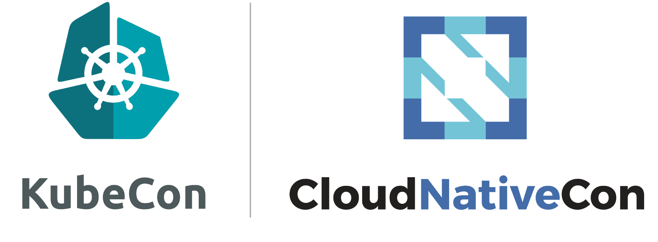
Conventions
China: November 14-15, 2018 Shanghai, China
Europe: May 21 – 23, 2010 Barcelona, Spain
North America: December 11 - 13, 2018 Seattle, WA
6/21/2018

Slide 177


Other Communities
Official Forum https://discuss.kubernetes.io
Subreddit https://reddit.com/r/kubernetes
StackOverflow https://stackoverflow.com/questions/tagged/kubernetes

Slide 178
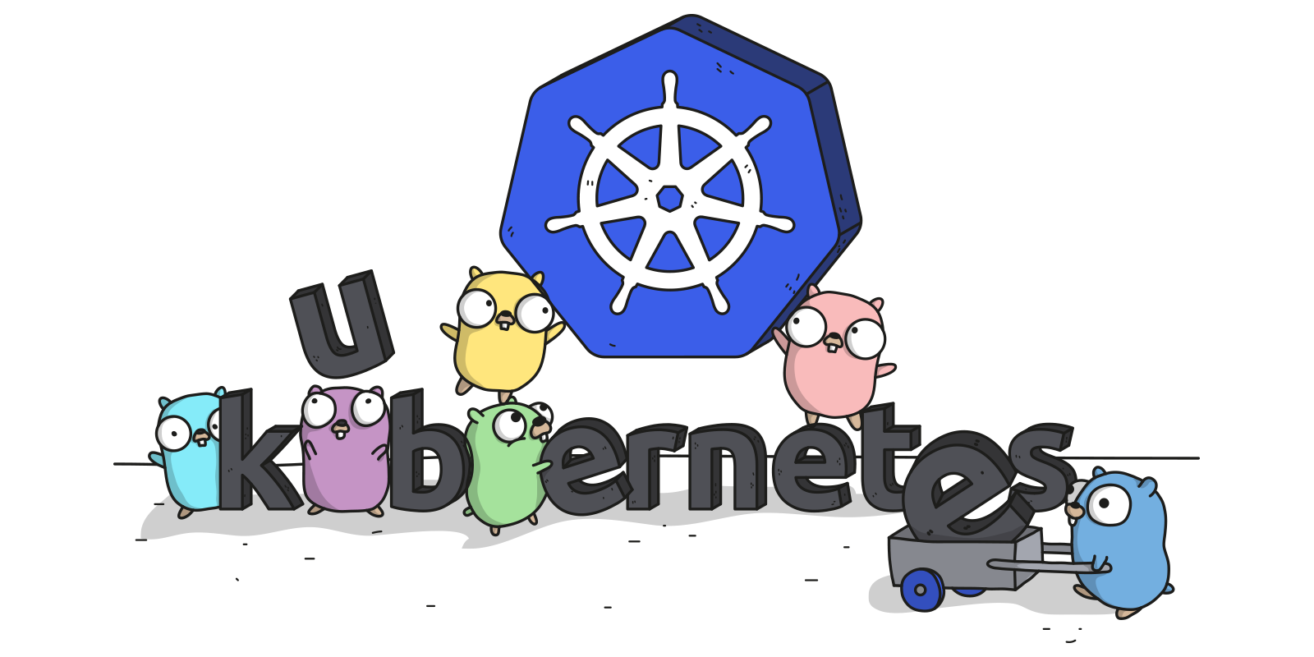
Links
Free Kubernetes Courses https://www.edx.org/
Interactive Kubernetes Tutorials https://www.katacoda.com/courses/kubernetes
Learn Kubernetes the Hard Way https://github.com/kelseyhightower/kubernetes-the-hard-way
Official Kubernetes Youtube Channel https://www.youtube.com/c/KubernetesCommunity
Official CNCF Youtube Channel https://www.youtube.com/c/cloudnativefdn
Track to becoming a CKA/CKAD (Certified Kubernetes Administrator/Application Developer) https://www.cncf.io/certification/expert/
Awesome Kubernetes https://www.gitbook.com/book/ramitsurana/awesome-kubernetes/details

Slide 179
Questions?

